Slide 1
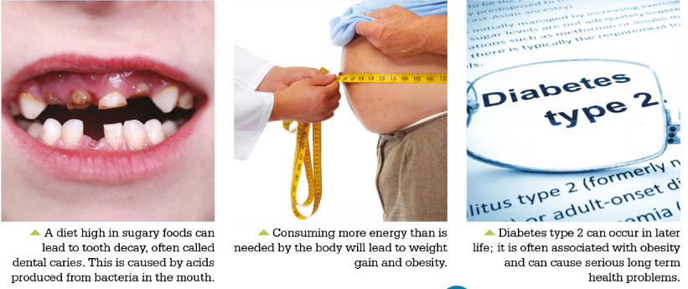
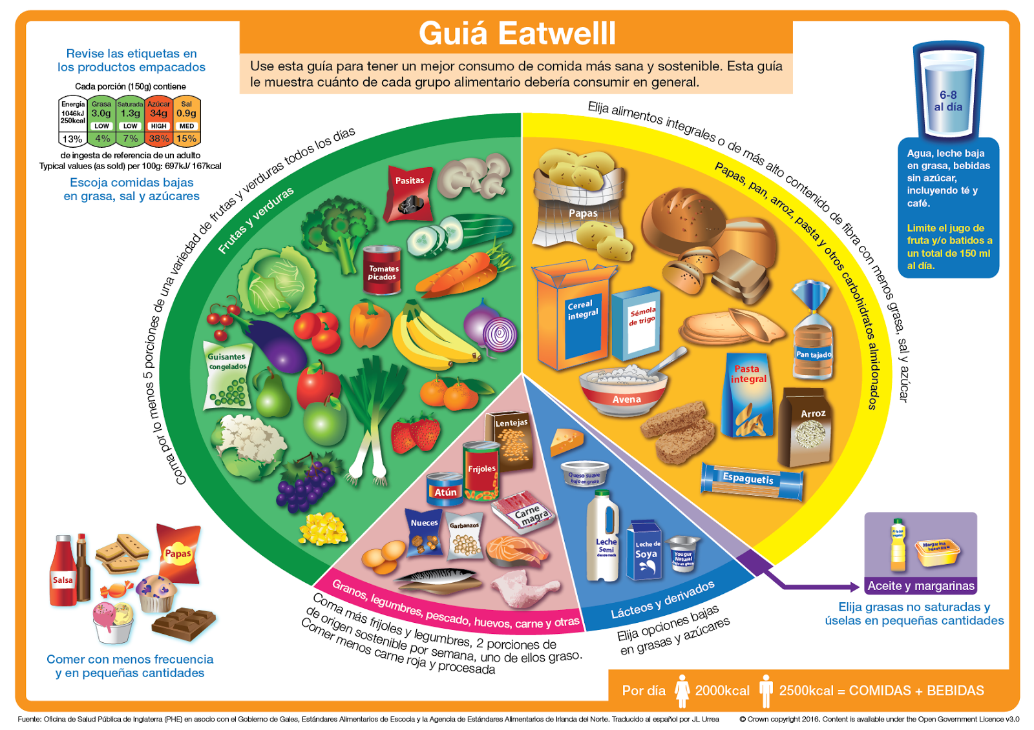
AQA Food Preparation & Nutrition Knowledge Organiser: Food, Nutrition & Health
You must be able to demonstrate knowledge and understanding of the functions, structures and main sources of protein, carbohydrates and fat. Know the biological value of protein, understand an individuals need for carbohydrate, understand the consequences of excess and deficiencies of protein, carbohydrate and fat.
Demonstrate the knowledge and understanding of the sources and functions of vitamins and minerals. Understand the consequences and deficiencies of vitamins and minerals. Understand the retention of water soluble vitamins during cooking.
Demonstrate the knowledge of the Eatwell Guide and health eating guidelines. Understand diet requirements throughout life and diet related illnesses
Keywords
Eatwell Guide
Reference Intake (RI)
Body Mass Index
Iron Deficiency anaemia
Osteoporosis
Foetus
Basal Metabolic Rate (BMR)
Physical Activity Level (PAL)
Estimated Average Requirement (EARs)
Key words
Amino Acids
High Biological Value (HBV)
Low Biological Value (LBV)
Protein Complementation
Kwashiorkor
Fatty Acids
Glycerol
Saturated Fats
Unsaturated Fats
Fat Soluble vitamins
Water Soluble Vitamins
Cholesterol
Hydrogenation
Trans fats
Dietary Fibre
Photosynthesis
Monosaccharides
Disaccharides
Polysaccharides
Non starch Polysaccharide (NSP)
Constipation
Diverticular Disease
Keywords
Fortified
Rickets
Osteomalacia
Antioxidant
Thiamin
Riboflavin
Spina bifida
Ascorbic acid
Peak Bone Mass
Haemoglobin
Anaemia
Thyroid
Dehydration
Lactating
KS4
Key Points
Protein is required by the body for growth, maintenance and repair.
Proteins are built up of units of amino acids.
Fats can be classified as either saturated and unsaturated.
Saturated fats are considered to be more harmful to health because they raise levels of cholesterol.
Carbohydrate provides the body with energy.
Most of our energy should come from complex starchy foods.
Vitamins are micronutrients, required in small amounts to do essential jobs in the body.
Water soluble vitamins are easily destroyed during preparation and cooking.
Water makes up two thirds of the body so it is vital to drink regularly to stay hydrated.
Nutritional needs change throughout life, but everyone needs to consider the current healthy eating guidelines when planning meals.
Energy balance is the balance of energy consumed through eating and drinking compared to energy burned through physical activity.
Assessment - NTT
What are the functions of fat in the diet?
Give an example of protein complementation.
What does NSP stand for?
What are the fat soluble vitamins
What is peak bone mass?
Why is a good supply of folic acid needed in early pregnancy?
What is Osteoporosis?

Slide 2
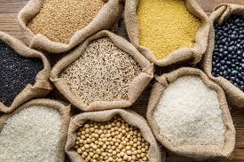
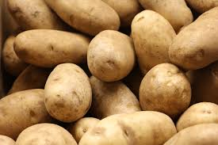
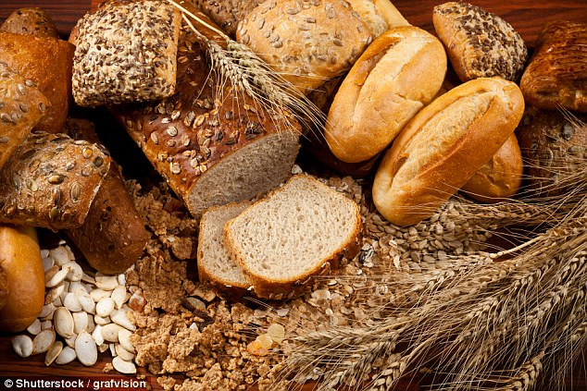
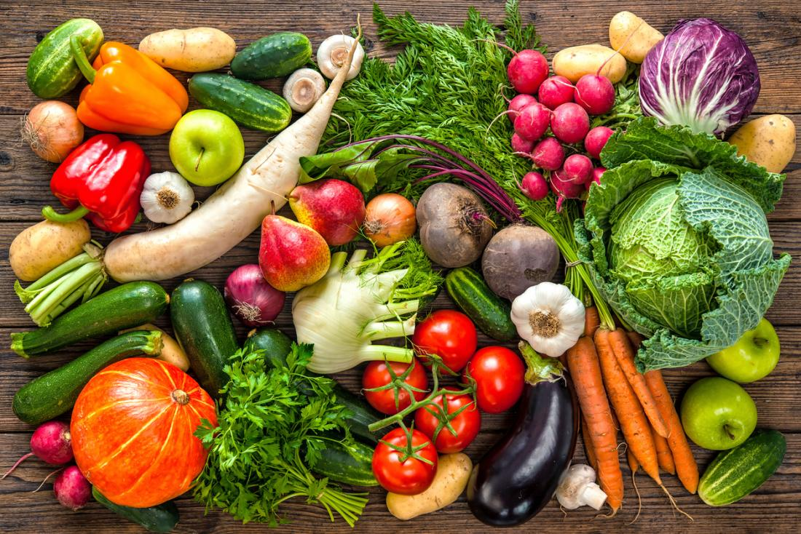
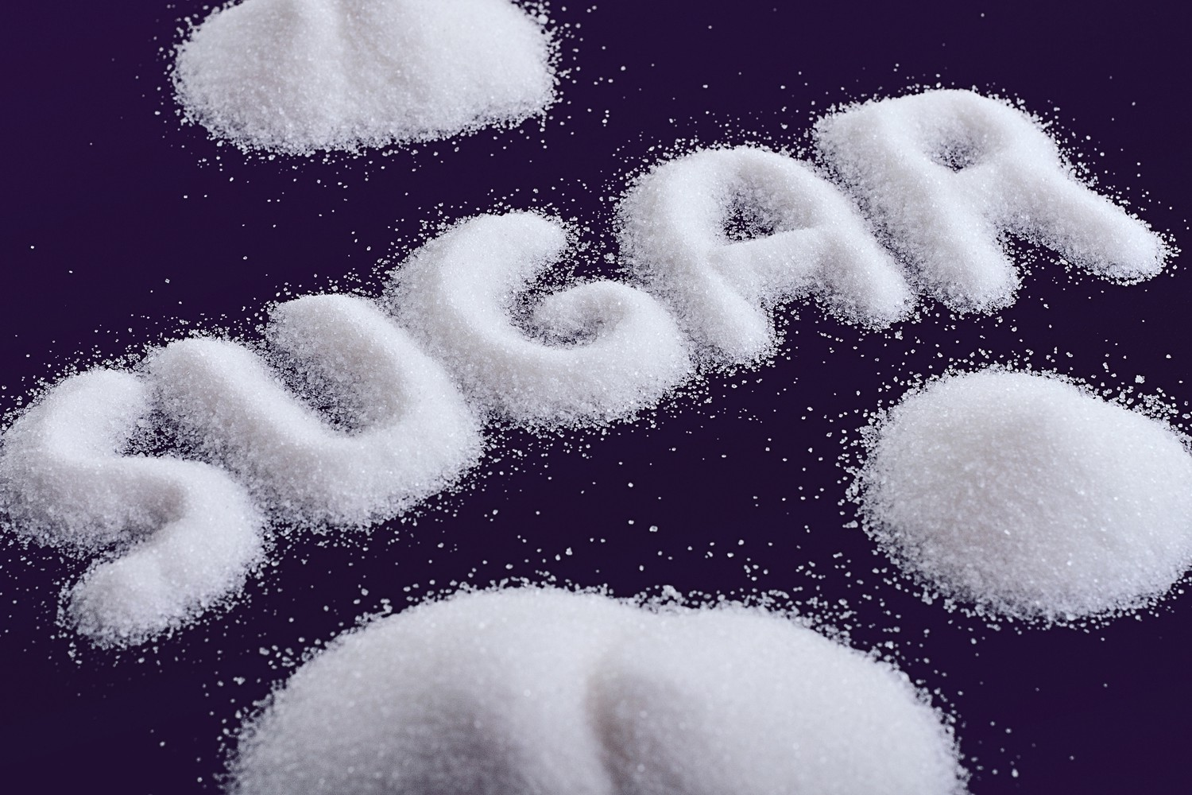
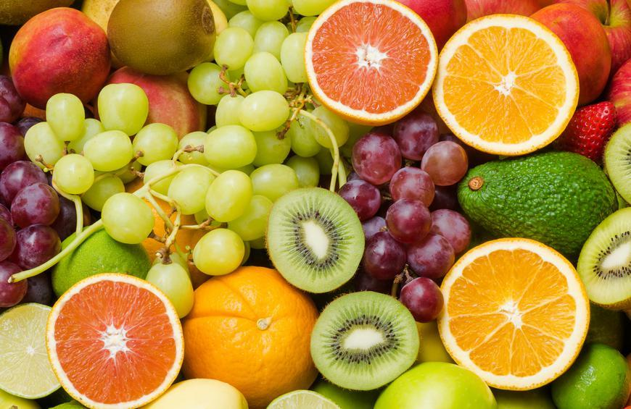
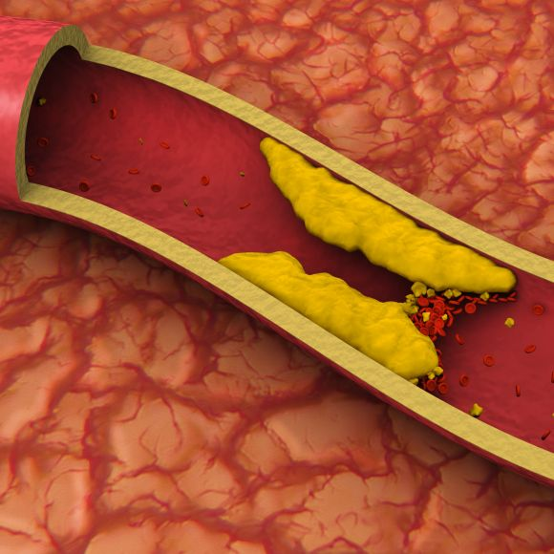
AQA Food Preparation & Nutrition Knowledge Organiser - Macro-Nutrients
Keywords and definitions:
Carbohydrates:
Protein:
Amino acids: small molecules that form long chains in proteins
Cholesterol: A type of fat found in the blood. It is made in the liver and obtained from saturated fatty foods.
Constipation: when faeces becomes difficult to expel from the body.
Disaccharide: when two monosaccharides join together to form a double sugar
Diverticular Disease: When pouches form in the intestines and become infected with bacteria.
Essential amino acids: x8 amino acids that can only be obtained through the diet
Fat-soluble vitamins: Vitamins A, D, E, K – are stored in the body longer than water-soluble vitamins
Fatty Acids: Fat is made up of fatty acids and glycerol
Glycerol: Part of a fat molecule
High Biological Value (HBV): Food sources such as animal proteins, that contain all essential amino acids.
Hydrogenation: Making a solid fat from a liquid fat
Kwashiorkor: A severe form of protein malnutrition.
Low Biological Value (LBV): Protein from plant sources, does not contain all essential amino acids (the exception is soya)
Monosaccharide: the simplest form of carbohydrates – single sugars.
Non-starch Polysaccharide (NSP): the scientific name for dietary fibre
Polysaccharide: - Long chains of monosaccharides
Protein Complementation: when LBV food are eaten together to provide all essential amino acids e.g. beans on toast
Saturated Fats: A fat that comes predominantly from animal sources
Texturised vegetable protein (TVP): A types of protein obtained from soya beans and made to resemble minced meat
Trans fats: When oil goes through the hydrogenation process
Unsaturated Fats: A fat that comes predominantly from plant sources
Carbohydrates predominantly provide the body with energy.
Carbohydrates are mainly produced by plants during photosynthesis
Sugars and Starches are types of carbohydrates (see below chart)
Complex carbohydrates are healthier than simple carbohydrates
Excess carbohydrates are stored as fat which can lead to obesity
Excess sugar can lead to dental decay and Type 2 Diabetes
Deficiency of carbohydrates can lead to loss of energy and weight, the body will use fat and protein as alternative energy sources.
Protein is required by the body for growth, maintenance and repair.
Proteins are made up of amino acids.
There are 8 essential amino acids, we have to get them from foods
Proteins with all 8 essential amino acids - High Biological Value(HBV)
Proteins without all 8 essential amino acids - Low Biological Value (LBV)
Animal sources (chicken, eggs, beef etc.), Quorn and TVP are HBV.
Vegetable sources (seeds, beans, nuts, lentils etc.) are LBV
Different LBV proteins can be eaten together to get all amino acids – this is called protein complementation
Excess protein is converted to energy. Also it can raise the levels of nitrogen in your body. Making your kidneys and liver work harder.
Deficiency of protein is rare, but Kwashiorkor can be seen in developing countries. This is severe malnutrition, often in young children.
Some groups of people need more protein than others e.g. babies and children for growth, pregnant women for the growing baby.
Do not taste sweet
Types of carbohydrates and their sources
Taste Sweet
Complex Carbohydrates:
Take longer to break down – give us slow release energy
Simple Carbohydrates:
Fast release energy – have less nutrient value
Polysaccharides
(long chains of sugars)
Polysaccharides
With no starch
Disaccharides
(double sugars)
Monosaccharides
(single sugars)
= essential amino acid = non essential amino acid
Starch
Fibre
Sucrose
Maltose
Glucose
Fructose
Lactose
Fat:
Water:
Dietary Fibre:
In the body, fat provides concentrated energy, fat-soluble vitamins, protects major organs and is a component of hormones.
Fat can be a solid or liquid.
Fat is made up of fatty acids and glycerol
Different fats have different melting temperatures, this is plasticity.
Saturated fat usually comes from animal sources and is solid at room temperature e.g. butter – these are more unhealthy
Unsaturated fat usually comes from plant sources and is liquid at room temperature e.g. olive oil – these are considered the “healthier” fats
Saturated fats can increase the cholesterol level in the blood
Unsaturated fats can reduce cholesterol in the blood
Making a solid fat from a liquid oil is called hydrogenation. Trans fats are produced during hydrogenation.
Trans Fats have been linked to health problems including heart disease and some cancers
Excess at can lead to weight gain and higher blood cholesterol levels, this can lead to obesity and coronary heart disease (CHD)
Fat deficiency in babies and children can affect normal growth
Fat deficiency in adults can result in deficiencies of fat-soluble vitamins.
The body needs water for
Normal brain function
Decrease the risk of kidney problems
Normal blood pressure
Help with bowel movements
Regulate body temperature
Maintain hydration
Making body fluids e.g. blood, saliva, mucus
Main sources of water include water, milk, tea, coffee and fruit juices
Some water comes from foods such as soup, yoghurt and fruit.
6-8 glasses of water should be drank every day
Some people will need to drink more water e.g. active people, people who are ill, elderly people, during hot weather.
The body needs fibre to help keep the digestive system moving.
Adults should eat 18g a day.
The scientific name for fibre is Non-Starch Polysaccharide (NSP)
Soluble NSP absorbs water forming a gel-like substance, this can help prevent the absorption of cholesterol.
Insoluble NSP is not absorbed by the body. It passes through the body as waste which helps prevent bowel disease.
Dietary Fibre makes food matter soft and bulky.
You can get fibre from wholemeal and wholegrain carbohydrates and vegetables
Fibre deficiency can lead to constipation and diverticular disease and sometimes cancer.
Cholesterol in the blood stream blocking arteries – directly leading to high blood pressure and CHD

Slide 3
Keywords and definitions:
AQA Food Preparation & Nutrition Knowledge Organiser - Micro-Nutrients
Antioxidant: these help protect cell membrane and to maintain healthy skin and eyes.
Deficiency: Having too little of something, that may cause a health problem
E:xcess Having too much of something, that may cause a health problem
Fortified: strengthening the nutritional content of a food by adding vitamins and minerals during production.
Haemoglobin: a red protein that gives blood its colour. It transports oxygen around the body using the red blood cells.
Mineral: an inorganic substance needed by the human body for good health
Night Blindness: a condition where you are unable to see in dim light or at night, typically caused by vitamin A deficiency
Osteomalacia: a medical condition where the bones become soft and weak due to the lack of Vitamin D and Calcium.
Osteoporosis: a medical condition where bones become weak, brittle and break easily.
Peak Bone Mass: When bones reach their maximum strength
Rickets: a childhood disease caused by lack of vitamin D; it causes the bones to soften, resulting in bow legs
Spina bifida: a defect of the lower spine that can result in paralysis in the legs and feet and is sometimes accompanied by learning difficulties
Thyroid: a gland at the front of your neck. It produces hormones that control the bodies metabolism
Vitamin: A group of organic compounds which are essential for normal growth and nutrition. They are required in small quantities in the diet because they cannot be synthesized by the body. If you are deficient in vitamins, you may need to take a vitamin supplement in the form of powder or tablet.
Vitamins:
Vitamin | Function | Source | Deficiency / Excess
A Retinol Fat-Soluble | Iron metabolism Vision – skin-mucus immune system | Liver – whole milk - green leafy veg -carrots – fortified marg | Excess – liver & bone damage / birth defects Deficiency – Night blindness
D Cholecalciferol Fat-Soluble | Absorption and use of calcium Bone and teeth strength | Oily fish – meat – eggs – fortified cereals - sunlight | Deficiencies – weak bones & teeth – Rickets in Children – Osteomalacia in adults
E Tocopherol Fat-Soluble | Skin eyes -Antioxidant protects cell membrane | Polyunsaturated fats e.g. sunflower oil – nuts - seeds | Very rare
K Phytomenadione Fat-Soluble | Normal clotting of blood | Green leafy veg – cheese – bacon - liver | Rare Newborn babies given a dose of Vitamin K
B1 Thiamin Water-Soluble | Release energy – nervous system – growth of children | Wholegrains – meat – dairy – nuts – fortified flour and cereals | Deficiency – Beriberi, a disease that affects the nervous system
B2 Ribflavin Water-Soluble | Release energy – nervous system | Same as Vitamin B1 | Deficiency – cracking skin around mouth – swollen tongue – growth issues
B3 Niacin Water-Soluble | Release energy from carbohydrates foods – nervous system | Dairy – meat – poultry – cereals – wholegrains | Deficiency – Rare but Pellagra could develop (diarrhoea, dermatitis, dementia)
B9 Folate / Folic Acid Water-Soluble | Neural tube development in unborn babies | Green leafy veg – potatoes- beans, nuts, seeds, - cereal - wholegrains | Deficiency – Spina bifida in unborn babies. Pre conception and pregnant women need a good supply
B12 Cobalamin Water-Soluble | Energy production – protective coating around nerve cells | Meat – fish – cheese – eggs – milk – marmite – fortified cereals | Deficiency – Pernicious anaemia
C Ascorbic acid Water-Soluble | Iron absorption – collagen production - antioxidant | Citrus fruits – blackcurrant – potato – green veg | Deficiency – weal connective tissue and blood vessels – bleeding gums - aneamia
Vitamin A, C and E contain antioxidants that work together to protect cells.
Vitamins B and C are water-soluble so will dissolve into water during cooking.
Vitamins B1 and C are destroyed by heat and Vitamin C is destroyed by exposure to oxygen.
To maximise vitamin retention:
- prepare foods quickly just before serving
- use small amounts of boiling water to cook
- use excess boiled water to make sauces as the vitamins will be in the water
-Avoid cutting lots of nutrients
-Cook foods with water soluble vitamins by steaming, grilling or roasting instead of boiling
-Cook foods with fat soluble vitamins by boiling, steaming or grilling instead of roasting
Mineral | Function | Source | Deficiency / Excess
Calcium | Strong bones and teeth – growth of children – blood clots – nerves and muscles | Milk – dairy – green leafy beg – fortified white bread – soya – fish eaten with bones (sardines) | Deficiency: bones don’t reach peak bone mass – osteoporosis – poor clotting
Iron | Production of haemoglobin to transport oxygen | Red meat – liver – lentils spices – chocolate – green leafy veg – fortified cereals | Deficiency: anaemia
Fluoride | Strengthen enamel on teeth | Saltwater fish – tea – fortified water | Deficiency: Dental cavities
Magnesium | Healthy immune system – bone and teeth growth | Spinach – brown rice – pumpkin seeds – mackerel | Deficiency: cramps and muscle spasms and weakness- migraines
Sodium | Regulate water in body – use of energy – control muscles and nerves | Processed foods – salt | Deficiency: Rare – cramps after exercise Excess: high blood pressure – heart disease - stroke
Iodine | Regulates hormones in the thyroid | Seafood – foods grown in iodine rich soil | Deficiency: tired – lethargic – swollen thyroid

Slide 4
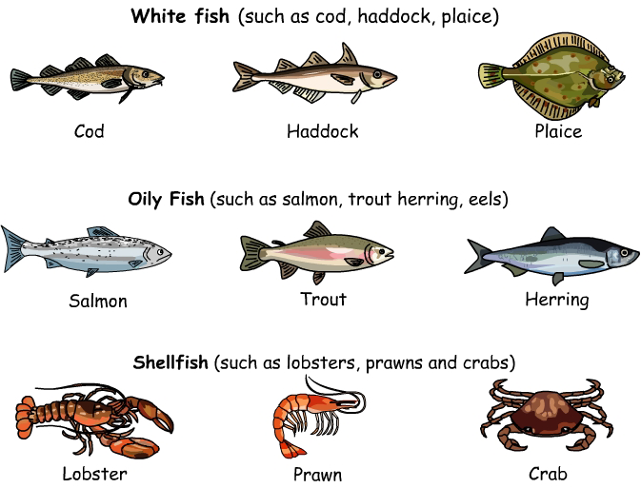
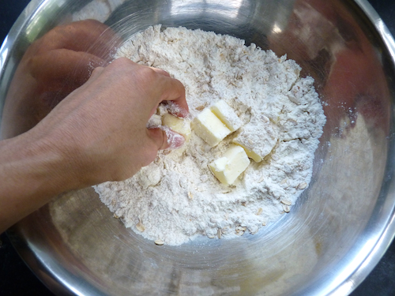
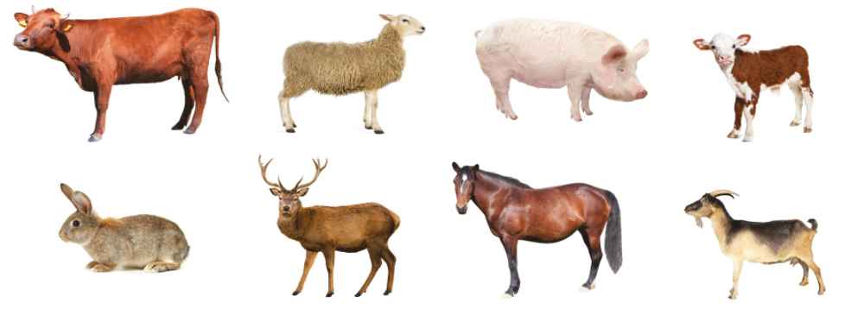
AQA Food Preparation & Nutrition Knowledge Organiser: Food Preparation Skills
You must be able to understand two different methods of using knives to prepare food safely. Explain the techniques used when preparing different foods that require knife skills. Know how to classify different types of fish. Explain how to choose, handle and prepare different types of fish.
Understand the structure of meat and how this affects the cooking methods used. Understand that a recipe consists of specific quantities of ingredients that are prepared, using a variety of skills, to produce the required outcome. Know that making and shaping dough is a precursor to making a variety of flour-based mixtures. Understand the function of ingredients in dough.
c
Keywords
Collagen
Elastin
Myoglobin
Muscle Fibre
Maillard Reaction
Non enzymic browning
Gelatine
Cross Contamination
Keywords
Ingredients
Precise
Combined
Rubbing-in
Binding
Coating
Enriched dough
Glazing
c
Keywords
Gliadin
Glutenin
Gluten
Carbon Dioxide
Shortcrust
Choux
Keywords
White fish
Salting
Connective tissue
Coagulate
Crustacean
Mollusc
Flat fish
Omega 3 fatty acid
Oil fish
Shellfish
Classification
KS4
Key words
Bridge hold
Claw grip
Jardinière
Julienne
Macedooine
Chiffonade
Batonnet
Dicing
Chopping
Paring
Flexible
Filleting
Serrated
Cooking
Key Points
Specific types of knives are designed for different cutting and shaping tasks.
Knives are dangerous if not handles correctly and care should be taken at all times.
A flat and stable cutting surface is essential to avoid injury when cutting food.
There are specific terms used for vegetable cuts relating to the size and shape of the outcome.
White fish carry oil in the liver; oil fish carry oil throughout the flesh.
Its important to wash your hands after handling fish to prevent cross contamination.
The length and type of cooking method depends on the type of muscle fibre.
Enzymic activity occurs when cut fruit and vegetables react with oxygen to turn them brown.
Various foods can be coated with ingredients to create a new layer to protect, add texture and flavour – this is called coating or enrobing.
Dough is made by mixing flour with liquid, and sometimes includes leavening (raising) agents as well as other ingredients and flavourings.
Assessment - NTT
Name the two methods of holding food when cutting it.
Which type of fish contains the most Omega 3 fatty acids?
Describe two quality checks for fresh fish.
Tough meat has what length of fibres?
Where would you store meat when not preparing it?
What glaze would you use on enriched dough?
What type of flour is used to make bread dough?
What gas does yeast produce?

Slide 5
Keywords and definitions:
AQA Food Preparation & Nutrition Knowledge Organiser - Food Commodities
Aerate: a food preparation process that adds air into a mixture
Allergy: When the bodies immune system is triggered by a substance (in this case food) – this can be fatal in some cases, particularly nuts.
Collagen: the main structural protein in connective tissue
Cross-contamination: transferring bacteria from one place to another
Gelatine: a water-soluble protein that comes from collagen and is used in food preparation; it is colourless and tasteless.
Imported: bought in from a different country
Intolerance: when the body is unable to digest certain foods, this can cause abdominal cramps, diarrhoea and vomiting. It is less severe than an allergy.
Micro-organism: another name for bacteria
Maillard Reaction: the browning of meat, caused by a reaction with natural sugars and proteins, which produce a dark colour; also known as non-enzymic browning
Muscle Fibre: cells that give structure to muscles; different structures of muscle fibre indicate different types od muscle
Non-starch Polysaccharide (NSP): dietary fibre – please see Macro-Nutrient Knowledge Organiser
Offal: the internal organs / leftover cuts of meat, used as food e.g. kidney
Salting: the process of adding salt to a foodstuff to remove its moisture; bacteria that could cause food poisoning cannot survive without moisture
Seasonal: The time of year when fruits and vegetables are naturally at their best or at their peak for harvest time
Smoking: the process od smoking a foodstuff to a temperature of 76˚C or above; this removes the moisture, extends shelf life and imparts a distinctive flavour.
Cereals, Flour, Oats etc.:
Fruit and Vegetables:
Meat:
Fish:
Bread: is a popular staple food - there are many different types – made with strong flour –
Cereals: Wheat, oats, rye and barley are grown in the UK. A cereal is a starchy edible grain. Used as a raw ingredient.
Flour: Wheat is the main cereal processed for flour. Can be white, self-raising, brown, wholemeal.
Oats: are grains from a cereal plant – has a protective husk that is removed during processing – can be used to make flour
Rice: grains that are harvested – can be short or long – white, brown or red – staple food
Potato: staple food – grown in the UJK – skin on outside
Pasta: made from flour and eggs – can be fresh or dried – can be coloured and flavoured.
MOST are a source of LBV protein, fibre, carbohydrates, b vitamins, iron and calcium
Fruit:
Four main groups of fruit, Hard, Soft, Citrus, Stone. Some fruits are also classed as exotic.
Many fruits are grown in the UK, those that aren’t are imported.
Many fruits are seasonal
Can be fresh, canned, dried, frozen – store as per instructions
Can provide various vitamins, carbohydrates, fibre (NSP)
Vegetables:
Grown above and below ground
Eight main groups; seeds, flowers, leaves, stems, shoots, tubers, root, bulb.
Can be cooked and preserved using a variety of methods
Provides various vitamins, calcium, iron, carbohydrates, fibre and protein.
Meat is the muscle tissue of dead animals
Fibres are held together with connective tissue. Long fibres = tough meat. Older animals = tough meat.
Slow cooking methods (stewing, braising, roasting) help tenderise meat
Marinades help with flavour and breaking down proteins
Maillard reaction helps brown the meat
As meat cooks, proteins coagulate. Collagen breaks down into gelatine.
Meat provides vitamin B6 and B12, iron, calcium, phosphorus, HBV protein, saturated fat, Cholesterol.
Care should be taken to avoid cross-contamination between raw meat and other foods.
There are 3 main classifications of fish; White, Flat, Oily.
There are 2 main classification od shellfish; Crustaceans, Molluscs.
High quality fish will have; bright eyes, salty smell, bright red gills, thin layer of slime, firm flesh.
Can be preserved by canning, freezing, Smoking and Salting.
Fish cooks quickly as the muscle is short and connective tissue is thin.
Fish can be grilled, baked, fried, steamed, poached.
Provides; HBV protein, iron, iodine, vitamin A & D.
Oily fish contains Omega 3 fatty acids for brain development and healthy bones and joints – our bodies cannot produce Omega 3 so it needs to be eaten.
Eggs and Poultry:
Butter, Oils, Sugars:
Milk, Cheese and Yoghurt:
Soya, Tofu, Beans, Seeds:
Poultry:
Poultry is chicken, turkey, duck and goose.
Muscle fibres in poultry are shorter than other meats, making it more tender.
Breast meat is always more tender than leg meat
Provides HBV protein, saturated fat some B vitamins, magnesium and phosphorus.
Eggs:
Regarded as one of the most versatile foods
Many functional and chemical properties: e.g. setting quiches, enriching dough, glazing pastry, binding ingredients, used as a raising agent.
Eggs can be; Factory Farmed, Barn Eggs, Free Range Eggs depending on the condition of the hen.
Provides HBV protein, fat, vitamins and Water.
Butter, Oils, Margarine:
Butter is a dairy product made from churning cream or milk. High in saturated fat. Solid at room temp. Used to aerate cakes, shorten pastry, add moisture and flavour.
Vegetable oils are used in food to marinade, fry and baste food. Naturally found in seeds.
Margarine is made from vegetable oils and some water. Vitamin A & D are added by law.
Sugar and Syrup:
Sugar comes from beet or cane. There are many different types of sugar. Used to provide colour, flavour, aeration in baked goods and prevent micro-organism growth in jams.
Syrup is often added to baked goods for colour and flavour.
Both are simple carbohydrates.
Milk:
Comes from a variety of animals.
Contains the sugar lactose so people with an intolerance must substitute.
Heat treated to kill harmful bacteria
Provides; HBV protein, fat, carbohydrates (lactose), Some vitamins, and calcium
Cheese:
Cheese is milk in solid form
There are regional and international varieties of cheese
Can be used for sweet or savoury dishes. Adds colour, flavour and texture.
Provides; HBV protein, fat, calcium, various vitamins.
Yoghurt:
Made from milk that has friendly bacteria culture added to it.
Types include Greek, set and live.
Same nutrients as milk
Soya and Tofu:
Soya grows in pods, can be fresh, dried or canned.
Used in processing for foods
Tofu is made curdling soya milk (known as bean curd)
Provide HBV Protein, B vitamins, calcium, iron, fibre.
Beans:
Beans, peas and lentils are known as legumes or pulses.
Excellent source of protein and fibre. Also provide B group vitamins, calcium and iron.
Staple food, can be canned, fresh, dried or frozen.
Nuts and Seeds:
Many different varieties
Some people have severe nut allergies
Lots of plants have edible seeds e.g. pumpkin, sunflower.
Provides fibre, B vitamins, fat, iron, zinc, calcium and protein.

Slide 6
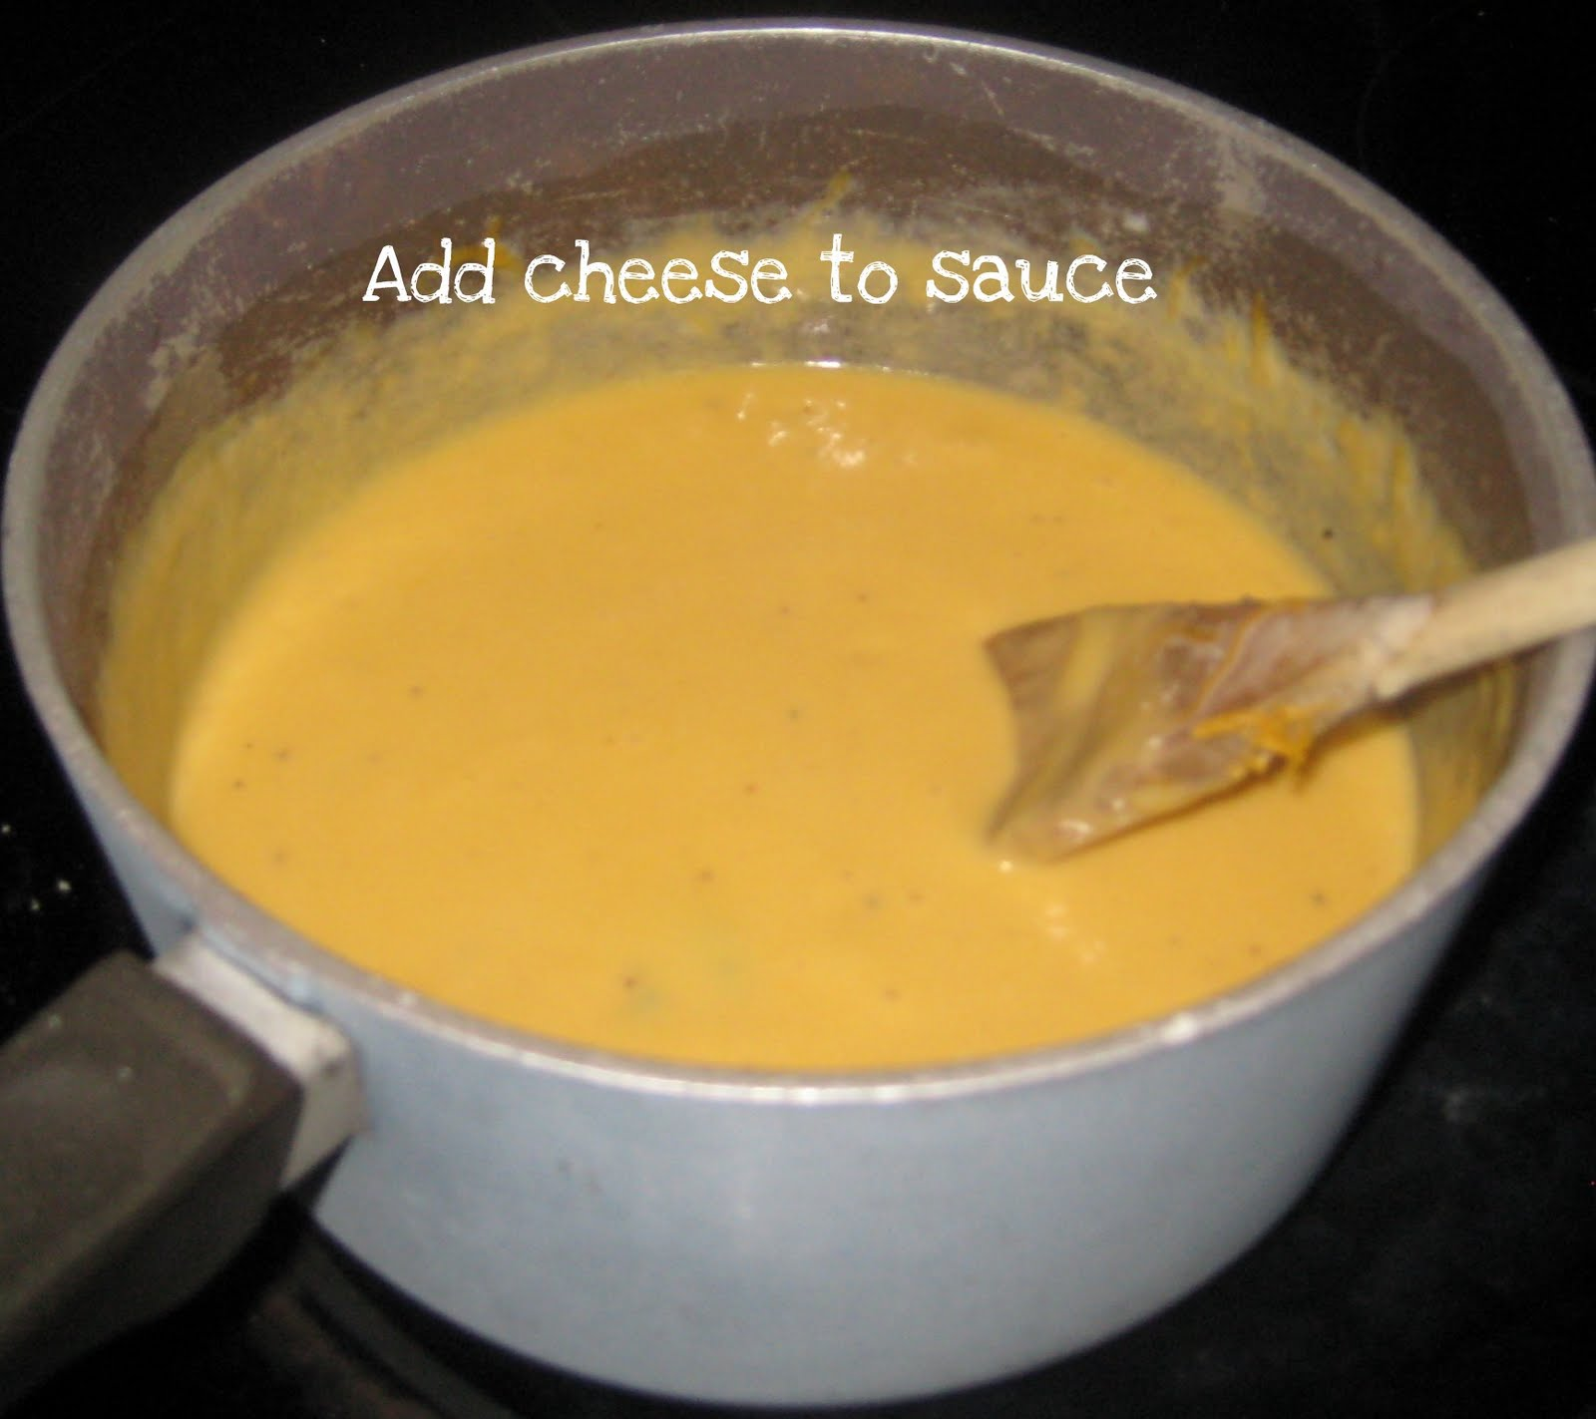
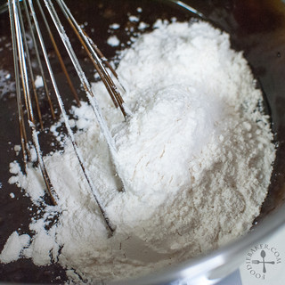
AQA Food Preparation & Nutrition Knowledge Organiser: Food Science
You must be able to know and understand the reasons why food is cooked and how heat is transferred to food. Know the reasons for selecting different cooking methods. Understand protein denaturation and coagulation. Know about the properties of protein in gluten formation. Understand enzymic browning and oxidation in fruit and vegetables. Understand the functional and chemical properties of carbohydrates, which are gelatinisation, dextrinization and caramelisation. Understand the processes of raising or aerating using physical and mechanical methods. Know and understand the working properties of chemical and biological raising agents.
Key words
Palatability
Microwave
Radiation
Conduction
Convection
Keywords
Denaturation
pH level
Marinade
Enzymic Browning
Oxidation
Keywords
Gelatinisation
Viscosity
Consistency
Dextrinisation
Caramelisation
Keywords
Shortening
Plasticity
Aeration
Creaming
Foam
Emulsification.
Keywords
Physical raising agents
Chemical raising agents
Yeast
Bicarbonate of soda
Baking Powder
Fermentation
Carbon Dioxide
Key Revision Points
Cooking food makes it safe, allows it to keep for longer and makes it more palatable.
Cooking methods can achieve specific characteristics in food.
Heat is transferred by conduction, convection and radiation. Cooking commonly uses a combination of heat transfer methods.
Proteins are denatured during cooking. Egg proteins coagulate or set when they are heated.
Wheat flour contains the protein gluten. Gluten forms the structure of pastries, breads and cakes.
Enzymes can cause the browning of fruit and vegetables. Fruit and vegetables need careful handling during preparation to prevent enzymic browning.
Gelatinisation is the function of starches as thickening agents.
Sauces can be different thicknesses when the proportion of ingredients is altered.
Dextrinisation is the term used to describe browning of starch caused by heat.
Caramelisation is the browning of sugars caused by heat.
Fat makes pastry short and crumbly.
Fats give colour and flavour to pastry. The plasticity of fat allows it to be used for rubbing in, spreading and creaming.
Fats can help aeration in baking.
Emulsions are mixtures of liquids that do not normally mix. E.g oil and water. Egg yolks contain lecithin, a natural emulsifier. Eggs help stabilise mayonnaise.
KS4
Assessment - NTT
Name three types of heat transfer.
Why is food cooked?
What is the term used to explain the way heat changes the texture of egg proteins?
What causes the browning of cut fruit and vegetables?
What is the main heat transfer method when boiling food?
What sort of heat transfer commonly causes dextrinization?
What term describes thickening a sauce using starch?
What term describes how fat makes a short texture product?
Which basic cake making process traps air into the cake?
How does egg white trap air?

Slide 7
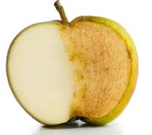
AQA Food Preparation & Nutrition Knowledge Organiser - Food Science Terms
Keywords and definitions:
Food Science and Carbohydrates:
Food Science and Proteins:
Amino Acids: small molecules that form long chains in proteins
Blanching: briefly immerse (an item of food) in boiling water, especially as a technique for removing the skin from nuts or fruit or for preparing vegetables for further cooking
Denaturation: changing protein function by heat, acid, pH or mechanical action.
Foam Formation: the creation of a foam by whisking eggs and sugar together. E.g. when making meringues.
Gluten: a protein found in wheat flour
Hydrophobic: one end of an emulsifier - hates water – forms chemical bonds with oils
Hydrophillic: one end of an emulsifier – loves water and forms chemical bonds with it
Irreversible: the changes are permanent and cannot be changed back
Kneading: working a bread dough to develop the gluten and smooth out lumps
Melting Temperature: The temperature that something melts at. Relevant to fats as different fats have different melting temoeratures.
Modified Starch: Starches that have been modified to perform additional functions
pH: The scale used to determine how acid / alkaline something is. 0 is neutral, 1 is the most acidic and 14 is the most alkaline
Pre-Gelatinised: a starch that is used to thicken instant desserts without heat e.g. angel delight
Short: the term used to describe a crumbly texture in food. E.g. shortbread biscuits or shortcrust pastry. Fat is used to coat flour particles during the rubbing in method. This keeps gluten strands short and creates the crumbly texture
Viscosity: how thick or thin a liquid is.
Gelatinisation
Occurs when starches (wheat flour, cornflour or arrowroot) thicken liquids. It also occurs during cooking with starchy foods such as rice, potatoes and pasta.
Starch particles absorb liquid, swelling up. As the temperature rises, the starch particles burst (80˚C), thickening the liquid e.g. in a roux sauce.
The process needs heat and stirring, especially in sauce making to prevent lumps forming.
More starch gives a thicker sauce, ratios can be changed to change the viscosity of the sauce
Modified starches are used in convenience foods such as gravy granules, quick cook pasta and pot noodles. Pre-gelatinised starch is an example.
Dextrinisation
Occurs when starch is toasted or cooked by dry heat e.g. bread / cake
The starch breaks down to dextrins. Dextrins taste sweeter than starch and add flavour to bread / baked goods
Dextrinisation changes the colour (longer it is heated the darker it gets) and texture (becomes more crispy) – e.g. toast getting darker
Caramalisation
Causes sugar to change colour and texture due to dry or moist heat.
Causes baked goods such as cakes to go golden brown.
Changes properties of sugar, it turns to syrup and tastes sweet and is glossy
Protein Denaturation
Denaturation occurs when the structure of amino acids is altered. They change shape or unfold because chemical binds are broken.
Protein can be denatured by:
Protein Coagulation:
Is a type of Denaturation
It causes a change in texture for example, runny eggs become solid. Examples are quiche and egg custard.
It starts as 60˚C and is completed by 70˚C – it is an irreversible process
Gluten Formation:
When water is added to wheat to form a dough. String bread flour is used for bread as it contains more gluten.
Gluten makes bread dough stretchy and elastic. Salt and kneading help strengthen the gluten. Gluten forms the structure of baked bread.
Gluten in pasta helps it hold its shape as well as making the dough flexible.
Heat | Proteins uncoil when cooked
pH | Reducing the pH (adding more acid such as vinegar / lemon juice in a marinade)
Enzymes | Helps tenderise meat causing denaturation
Mechanical Actions | Whisking e.g. foam formation with eggs
Food Science and Fats / Oils:
Oxidation:
Enzymic Browning:
Shortening
Is the process that creates a “short” crumbly texture e.g. pastry
The rubbing in method is used to coat flour particles in fat. This prevents long gluten stands from forming.
The shorter the gluten strands are, the more crumbly a pastry is.
Pasticity:
Means the ability of a fat to change properties over a range of temperatures. This is due to the combinations of chemicals called triglycerides.
Different fats have different melting temperatures. Some products are created with lower melting e.g. Flora so it can be used straight from the fridge. Other fats such as lard will be solid in the fridge, but will soften as it gets warmer.
Aeration
Helps a product have a light and open texture.
Aeration increases the volume of a product by incorporating air through beating, whipping, creaming, and whisking.
Fat and sugar beaten together trap air, this is called the creaming in method and often used in cake making.
Emulsification:
Emulsions are mixtures of liquids that do not normally mix e.g. water and oil e.g. mayonnaise
Emulsifiers have a hydrophobic and a hydrophilic end, meaning the water and oil can be combined together.
Stabilisers keep emulsions mixed preventing them from spreading.
Emulsification is the process of creating an emulsion.
Egg yolks are a natural emulsifier as they contain lecithin.
Oxidation causes discolouration e.g. cut lettuce leaves turn pink / brown
Oxidation causes vitamins to be lost, especially Vitamin C
It enables enzyme activity
Oxidation can be reduced during preparation and cooking of food by;
Use small amounts of water to boil vegetables
Use a quicker method of cooking e.g. steaming / stir fry
Serve vegetables immediately after cooking
Keep the lid on when boiling vegetables
Use the cooking water (this will contain lost water-soluble vitamins) to create other sauces e.g. gravy
This occurs on the surface of cut fruits such as apples and on the surface of cut vegetables such as potatoes.
It happens due to cell enzymes reacting with the air.
Enzymic browning can be prevented by:
Blanching cut fruits or vegetables
Blanching vegetables before freezing
Dipping fruit or vegetables in acid (e.g. lemon juice)
Remove contact with air by submerging under water
Cooking as soon as vegetables are cut.

Slide 8
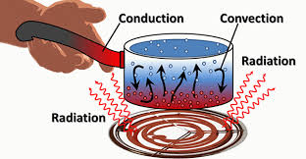
Keywords and definitions:
AQA Food Preparation & Nutrition Knowledge Organiser - Cooking Food
Aerate: to incorporate air into a mixture – also aeration.
Conductor: a material or device that conducts or transmits heat or electricity
Foam: When bubbles form on the surface of a liquid as a result of a chemical reaction. Or the creation of a foam substance by whisking eggs and sugar together.
Methods of Cooking: The ways in which different foods can be cooked e.g. baking, steaming etc.
Micro-organisms: a microscopic organism, especially a bacterium, virus, or fungus
Palatable: (describing food or drink) has a pleasant taste, is pleasant to eat
Raising Agents: a substance added to a food product that makes it rise when cooked
Raw: food that has not been cooked
Shelf life: the length of time that a food / drink may be stored without becoming unfit for use, consumption or sale.
Unleavened: refers to bread, cakes and biscuits that are made without a raising agent.
Why do we cook food?:
Raising Agents:
Raising agents are added to most baked products during the making process using gas, air or steam which, when heated, expands causing the food to swell and rise up. Raising agents produce a risen, light and airy texture in the food.
Mechanical Raising Agents Create air through an action | Chemical Raising Agents Create Carbon Dioxide
Sieving will trap air. Used in pastry, cakes or batters | Self raising flour is plain flour with baking powder added in the correct quantity needed to suit most cakes
Whisking eggs. Eggs and caster sugar, when whisked will trap a large volume of air creating a foam. | Baking Powder – is a commercially made mixture of bicarbonate of soda and cream of tartar. Baking powder works the same as Bicarbonate of soda, but adding cream of tartar helps stop the soapy flavour
Rubbing fat into flour will incorporate a little air
Creaming fat and sugar together traps minute bubbles. The fat becomes paler in colour and the mixture looks creamy | Bicarbonate of soda + moisture + heat will create bubbles of carbon dioxide to raise the food. It can leave behind a “soapy” flavour
Lamination air is trapped each time flaky and rough puff pastry dough is rolled and folded to create layers
Physical Raising Agents | Biological Raising Agents
Steam is created in products such as Yorkshire puddings and choux pastry which contain large quantities of water. Ovens are set to high temperatures to turn water to steam and forces it through the mixture, pushing or raising it upwards | Yeast is a living organism grown commercially for bread making and alcohol production. Yeast + moisture + oxygen + food + time will produce masses of carbon dioxide gas bubbles
Make it safe to eat – cooking destroys micro-organisms, reducing the chances of food poisoning
To change it from raw to cooked – many foods cannot be eaten in their raw form
To make it more palatable, improving texture, developing flavours and improving colour
To extend the shelf life of a product
To make it easier for us to digest
To give variety to the diet – e.g. eggs can be cooked many different ways for different tastes and textures
Heat Transfer:
Heat transfer is the way heat is transferred into foods in order to cook them. Many methods of cooking combine two methods of heat transfer, e.g. roasting vegetables uses both conduction and convection.
Conduction: The transfer of heat by direct contact from a hot surface. This is a relatively slow method of heat transfer because there must be physical contact. Surfaces must be a good conductor of heat, which is why saucepans are made of metal, but the handles are plastic.
Convection: The transfer of heat through movement in a gas or liquid. Warm air or liquid current rise up (e.g. in a saucepan or oven) pushing the cooler air / liquid down, which is in turn heated. This creates a cycle of currents which can heat the food.
Radiation (Microwave): A microwave converts electricity to radio wave (called microwaves) which penetrate the food.
Radiation (Infra-red radiant heat): The heat is transferred using electromagnetic radiation: waves of heat or light strike the food. There is no physical contact between the heat source and the food being cooked.
Accurate heat control:
Oven: always use the oven temperature stated in the recipe. If the food browns too quickly, turn the oven down by 10° or move food to a lower shelf.
Hob: Water boils at 100°C. If boiling water is left on a high heat, it will evaporate, causing the contents of the pan to burn. Take care when using oil/fat as it can spontaneously ignite at temperatures between 180°C and 250°C.
Grill: the heating element should be glowing red before placing food under the grill. Food must be checked regularly and turned over to prevent burning.

Slide 9
AQA Food Preparation & Nutrition Knowledge Organiser - Methods of preservation and cooking
Methods of cooking:
Methods of Preservation:
Dry Heat Methods of cooking | Examples | Advantages | Disadvantages
Baking – food is cooked in the dry heat of the oven | Cakes Pastry Bread | Good colour Good texture Several items can be baked | Needs specific times and temperatures
Roasting – food is cooked using dry heat of the oven but basted with fat | Meat Vegetables | Good flavour Crisp texture Items can be roasted together | Takes a long time to cook Additional fat content
Toasting – Dry heat is applied to food | Bread Nuts Seeds | Lowers the Glycaemic Index Adds Flavour | Food can burn quickly
Grilling – Dry heat is applied by a hot grill either above or below | Sausage Bacon | Healthier as fat drains from meat Quick | Food can burn quickly
Dry Heat Methods of cooking | Examples | Advantages | Disadvantages
Shallow Frying – small pieces of food are cooked in hot shallow oil | Meat Vegetables | Quick method of cooking | Additional fat content Health and Safety issues
Deep Frying – Foods are submerged in hot fat / oi | Chips Chicken Fish | Quick Golden, crunchy texture | Additional fat content Health and Safety issues
Moist Heat Methods of cooking | Examples | Advantages | Disadvantages
Boiling – starchy food is cooking in boiling water | Potatoes Pasta rice | Quick No added fat Softens food | Water soluble vitamin loss
Steaming – food is cooked in the steam of boiling water | Fish Vegetables | Water soluble vitamins are not lost Healthier Food is easy to digest | Can take a long time Causes condensation
Poaching – Food is cooked in a small amount of simmering liquid | Meat Fish Eggs | Healthy Quick | Loss of water soluble vitamins Food can break apart Bland taste
Stewing – Food is submerged in liquid and cooked slowly to develop flavours and tenderise meats | Meat Fish Beans lentils | Meat is tenderised Good developed flavour Water soluble vitamins are absorbed into the sauce / gravy | Need to plan ahead as takes a long time (2-3 hours)
Methods of Preservation | Examples | Advantages | Disadvantages
Heat – Heat kills most micro-organisms and it stops any enzyme activity | Pasteurisation of milk All cooked food Canned foods | Makes the food safe to eat Can speed up cooking time for the consumer | Doesn’t kill heat resistant bacteria
Freezing – The microorganisms become inactive at very cold temperatures but will start reproducing during defrosting. | Frozen meat / fish Readymade meals Desserts | Food can stay fresh when travelling over long distances Increased shelf life | More expensive due to transport and equipment to keep food frozen
Drying – Microorganisms need moisture to reproduce | Pot noodles Coffee Milk Soups Gravy granules | Cheap to do Food takes up less space Increased shelf life | Can take away from flavour and texture of foods
Removing Air (Oxygen) – Most microorganisms need oxygen to reproduce. Food items are sealed in cans, jars, MAP, vacuum packaging | Canned food Food in jars Meat and fish Sandwiches Crisps | Longer shelf life Preserves the taste and texture MAP (modified atmosphere packaging) is designed to let oxygen in and carbon dioxide out to maintain the environment | MAP – bad for the environment Jars and cans are heavy (increased transport cost)
Chemicals: salt, sugar, vinegar, smoke – The pH levels needed for bacterial growth and enzymic action are changed | Salted meat and fish Pickles Chutneys Jams | Changes the flavour (e.g. pickled onions) Extended shelf life | If extra salt is added can be less healthy Takes a long time for the process
Irradiation – Food is exposed to low doses of radiation which kills all micro-organisms | Herbs Spices Some vegetables and fruit | Delays food from ripening (allowing it to be sold for a longer period) Can help prevent vegetables from sprouting roots | Loss of nutrients Consumer concern, leading to avoidance

Slide 10
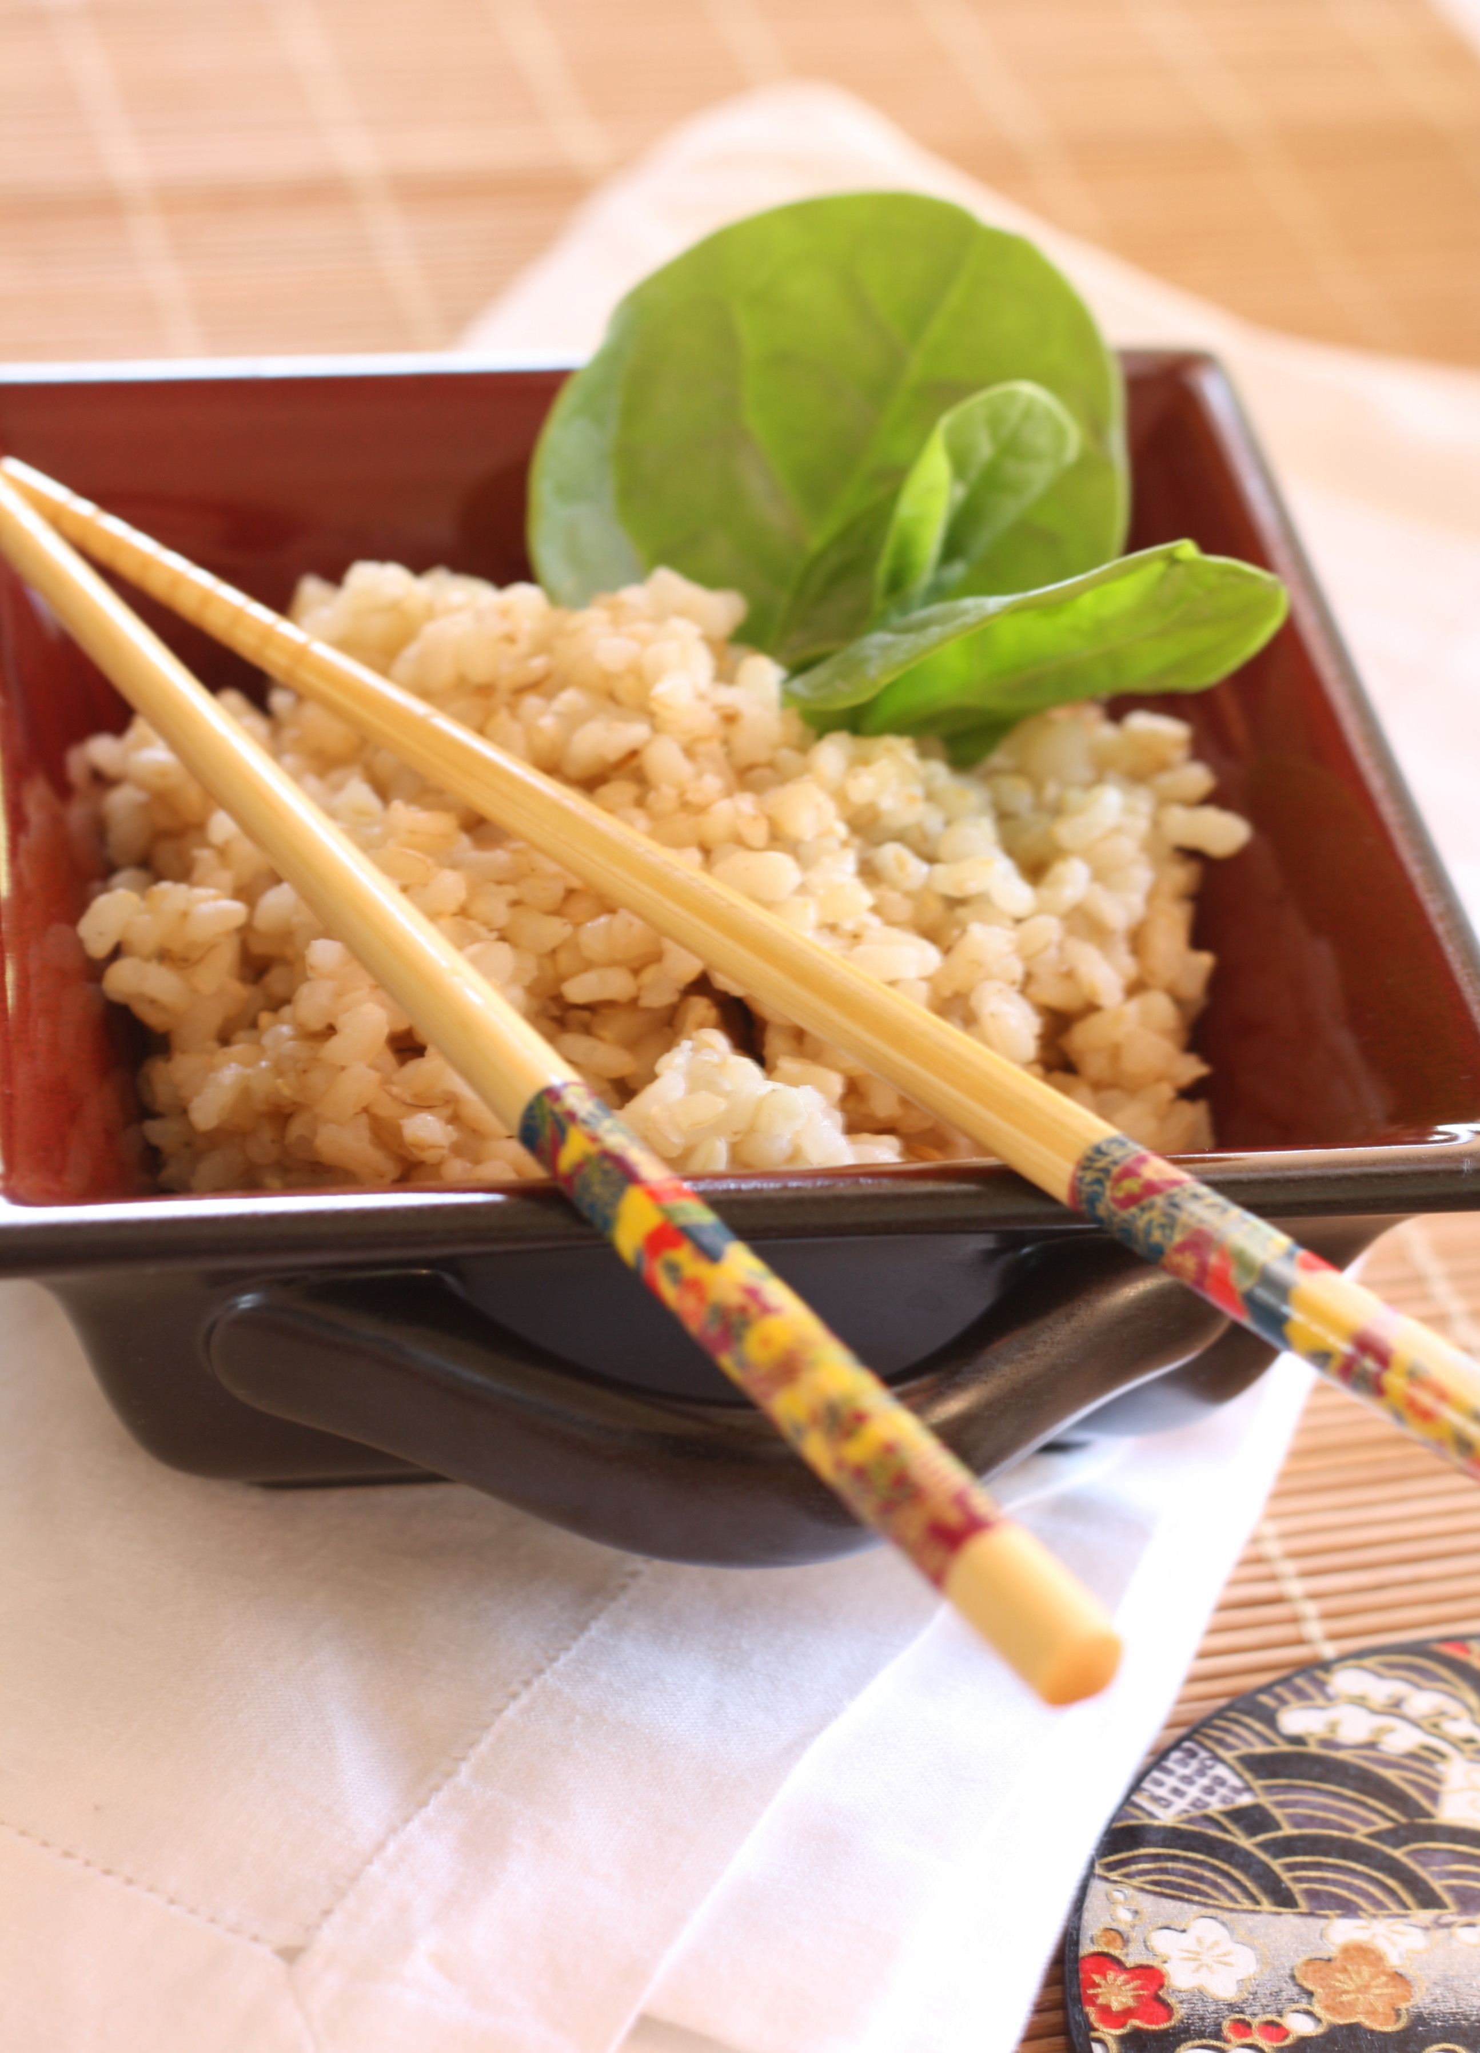
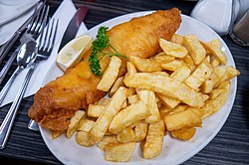
KS4
AQA Food Preparation & Nutrition Knowledge Organiser: Food Choices
You must be able to understand that religions, customs and beliefs influence food choice. Know about conditions that may be caused by intolerance or allergy to food. Understand the meaning of ‘cuisine’ in terms of the food related to the traditional eating habits of certain countries. Learn about the cuisine of two other countries as well as British traditional cuisine. Understand how to taste food products using your senses accurately. Know about a range of sensory testing methods. Know which information is legally required for a food label. Explain how this information will help the consumer. Understand the ways in which nutritional labelling can be presented. Provide reasoned suggestions for food choice based on a range of factors.
Keywords
Cardiovascular
Eatwell Guide
Healthy eating
Physical Activity Levels (PAL)
Availability
Seasonality, Lifestyle
Keywords
Regional
Multicultural
Cuisine
Key words
Kosher
Halal
Vegetarian
Ovo-lacto vegetarian
Vegan
Lacto vegetarian
Ethical
Diabetes
Coeliac
Gluten
Protein
Malnutrition
Lactose intolerance
Allergy
Anaphylaxis
Epi pen
Keywords
Senses
Taste
Aroma
Texture
Olfactory
Sensory analysis
Palate
Sensory characteristics
Rating Tests
Ranking tests
Star profile
Triangle testing
Paired preference tests
Key Points
If you can’t tolerate certain foods you have to change your diet.
Some religions have their own dietary laws and rules.
Diabetes is a condition caused because the pancreas doesn’t produce any or enough insulin.
Coeliac disease is a condition where people have an adverse reaction to gluten.
Lactose intolerance is caused when the body is unable to digest lactose (a sugar found in milk and diary products).
An allergy to nuts can cause anaphylaxis.
The reasons why people become vegetarian include religion, dietary laws, ethical reasons, health or family.
Cuisine relates to the established range of dishes and foods of a particular country or religion.
Cuisine is also concerned with the use of distinctive ingredients and specific cooking and serving techniques.
Accurate sensory testing of foods helps manufacturers and cooks develop food products and improve recipes.
The human olfactory system (smell) and taste sensors are important when tasting food.
EU= European Union
FSA=Food Standards Agency
People need to make informed choices about the food they buy based on their income, lifestyle and preferences from the food available to them.
Many factors affect the food choices that people make.
Assessment - NTT
What religions traditionally do not eat pork?
Which foods can people with coeliac disease not include in their diets?
Name two traditionally British dishes.
Why is it important to use codes when tasting foods?
List the stages used to carry out a controlled sensory analysis
What is triangular testing?
What information must be included on food labels by law?
What does PAL mean?
Explain the different factors that affect peoples food choice.

Slide 11
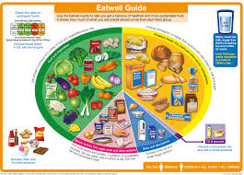
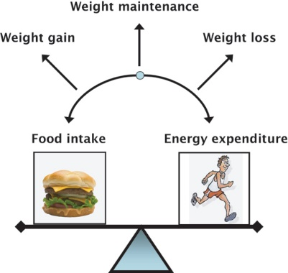
Keywords and definitions:
AQA Food Preparation & Nutrition Knowledge Organiser - Diet and Good Health
Anorexia: an emotional and mental health disorder characterized by an obsessive desire to lose weight by refusing to eat.
Basal Metabolic Rate (BMR): the energy needed by the body to power your internal organs when completely at rest
Body Mass Index (BMI): a measure that adults can use to see if they are healthy weight. The ideal BMI is between 18.5 and 25
Bulimia: an emotional and mental health disorder characterized by a distorted body image and an obsessive desire to lose weight, in which bouts of extreme overeating are followed by fasting or self-induced vomiting or purging.
Colostrum: the first milk produced by a breast feeding mother
Energy Density: the amount of energy, calories (Kcal) or kilojoules (KJ) a food contains per gram. Fat = 9 Kcal per g, Protein = 4 Kcal per g, Carbohydrate = 4 Kcal per g.
Estimated Average Requirements (EARs): tables used by nutritionists that provide guidelines to the energy needs of individuals at various stages of life.
Ethical: decisions or actions taken on the basis of strongly help moral beliefs or intellectual principles
Foetus: a baby still in the womb
Halal: meat that can be eaten by Muslims because it has been killed in accordance with Islamic law
Haram: forbidden or proscribed by Islamic law
Kosher: food that conforms to Jewish dietary law
Lethargy: a lack of energy and enthusiasm
Malnutrition: is a result of under-consumption of nutrients. Anorexia and bulimia can lead to malnutrition symptoms.
Menstruation: the monthly process the female body goes through to discharge the lining of the uterus; takes place from puberty to menopause.
Osteoporosis: a disease common in old age. Bones become weak and brittle. A calcium and vitamin rich diet is needed for bone strength.
Physical Activity Level (PAL): the energy needed by the body for movement of all types
Puberty: the stage of life when adolescents become mature and become capable of sexual reproduction.
Reference Intake (RI): the approximate amount of a nutrient provided by a portion of food.
Weaning: to introduce a baby to solid food.
Eat Well Guide and Government Guidelines:
Energy Balance:
Life Choice Nutritional Needs:
The Eatwell Guide shows the proportions of food groups that should be eaten daily in a well-balanced diet. There are 8 main government guidelines for a healthy diet
Base your meals on starchy carbohydrates
Eat lots of fruit and veg (5-7 portion a day)
Eat plenty of fish, including oily fish
Cut down on saturated fat and sugars
Eat less salt – no more than 6g a day
Get active and maintain a healthy weight
Drink 6-8 glasses of water a day
Always eat a healthy breakfast
Energy balance is when you use the same amount of energy that you intake through food. This results in weight maintenance.
Too much energy intake can result in weight gain.
Too little energy intake can result in weight loss and lethargy.
You can work out how much you should be eating: BMR x PAL = EAR
Guidelines suggest at least 60 minutes of activity a day.
Pregnancy: A healthy diet to ensure the baby receives the essential nutrients required for development. Folate (folic acid) is needed for the development of the neural tube of the foetus. The baby’s bones need a good supply of calcium. An iron rich diet is needed to create a supply of iron for the baby. Constipation is common so a high fibre diet is needed.
Vegetarian: Do not eat meat, fish, poultry or gelatin.
Ovo-Lacto Vegetarians: eat eggs and dairy (but only cheese made with vegetable rennet)
Lacto Vegetarian: eat dairy and honey but do not eat eggs
Vegan: Do not eat any foo with an animal origin, this includes things like honey and avocado.
People are often Vegetarian / Vegan due to ethical reasons. They must get their iron, Vitamins D and B12 from other sources to prevent malnutrition.
Nutritional Age Needs:
Religious Needs:
Babies: Newborn babies only drink milk for the first 4-6 months before being weaned. First milk is called colostrum. Human milk provides all nutrients except iron, babies are born with an iron store in their liver.
Children: 1-3 yrs grow quickly so needs a well balanced diet for development. Toddlers are very active and need a good supply of fat for energy, this also helps with brain and nervous system development. New foods should be introduced in an attractive and appealing way. They should avoid sweets, fizzy drinks, sugary foods.
Teenagers: Rapid growth and puberty occurs. They need a higher amount of nutrients and energy. Boys need protein for muscle growth. Girls need more iron to replace blood loss during menstruation, they are prone to iron-deficiency anaemia.
Adults and Older People: Adults need to maintain a healthy balanced diet to keep the body working properly and prevent diet-related problems. In older people, energy requirements decrease so they need smaller portions and less calories. They must keep hydrated and drink plenty of fluids. Osteoporosis may occur and so a diet high in calcium and vitamin D is needed to strengthen bones.
Judaism | Shellfish or pork No dairy food eaten in the same meal as meat Only Kosher meat can be eaten
Hinduism | No beef or beef products & will avoid pork Some Hindus Practice Fasting Foods such as onion, garlic and alcohol, thought to “excite” the body are forbidden Many Hindus are Vegetarian
Islam | No pork Only Halal meant can be eaten Haram foods cannot be eaten Ramadan is a fasting month, at the end of Ramadan Eid-ul-Fitr takes place
Sikhism | No beef Many Sikhs are vegetarian or Ovo-lacto vegetarian
Christianity | No particular dietary requirements, though some foods are associated with celebrations e.g. pancakes on shrove Tuesday and hot cross buns at Easter
Buddism | Vegetarian
Rastafarianism | Vegetarian or Vegan White fish are sometimes eaten (but no shellfish)

Slide 12
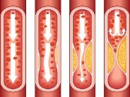
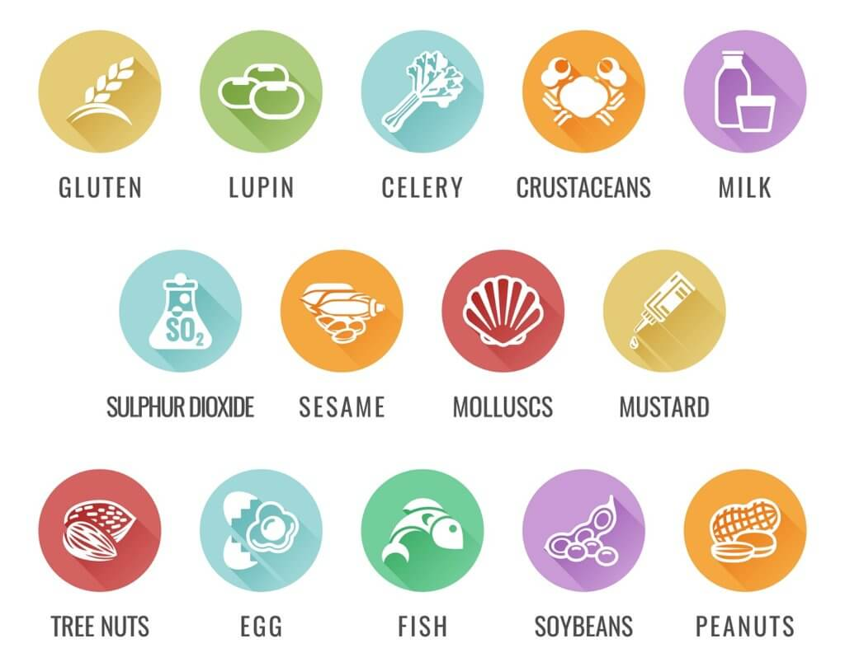
AQA Food Preparation & Nutrition Knowledge Organiser - Diet related medical conditions
Keywords and definitions:
Obesity:
Cardiovascular Disease (CVD)
High Blood Pressure:
Bowel Cancer:
Anaphylaxis: an acute allergic reaction to a food e.g. nuts, that in extreme cases can lead to death. This is due to the swelling of the throat, meaning air is cut off and people cannot breathe
Allergen: A substance that causes an allergic reaction. There are currently 14 allergens that must be identified on food packaging and menus by law in the UK.
Allergy: When the bodies immune system is triggered by an allergen (in this case food) – this can be fatal in some cases, particularly nuts.
Diarrhoea: When faeces is liquid in form and is removed from the body on a regular basis
Diverticular Disease: when pouches form in the intestines that then become infected with bacteria
EpiPen: A device containing medicine that treats an extreme allergic reaction. It must be injected. People suffering anaphylaxis must still go to the hospital, even if an epipen has been used.
Faeces: Waste matter that is removed from the body through the bowel – excrement (poo)
Intolerance: when the body is unable to digest certain foods, this can cause abdominal cramps, diarrhoea and vomiting. It is less severe than an allergy.
Malnutrition: is a result of under-consumption of nutrients. Anorexia and bulimia can lead to malnutrition symptoms.
Nausea: A feeling of sickness / feeling like you will throw up.
Osteoporosis: a disease common in old age. Bones become weak and brittle. A calcium and vitamin rich diet is needed for bone strength.
An abnormal accumulation of body fat.
Anyone with a BMI of over 30 is considered obese
Will lead to an increased risk of CHD, diabetes, cancer and high blood pressure.
Causes joint and mobility issues as well as shortness of breath.
People who are obese should reduce their intake of foods high in salt, sugar and saturated fats.
A standard term for conditions affecting the heart or blood vessels, there are many different types.
Coronary Heart Disease (CHD) is a common type where fatty substances (cholesterol) builds up in the arteries that run to the heart.
People suffering from CVD should reduce their intake of salt and saturated.
High blood pressure can lead to an increased chance of stroke and heart attacks.
Eating too much salt can increase your blood pressure.
Recommendations are that you should only eat up to 6g a day, but many people eat more due to salt being hidden in many pre-packaged foods.
Is the second biggest cause of death and illness in the UK.
The risk of bowel cancer and diverticular disease can be greatly reduced by increasing fibre / NSP (non-starch polysaccharide) intake.
Vegetables, wholegrains, beans and pulses are all good sources of fibre.
Pressure restricting blood flow
Type 2 Diabetes:
Liver Disease:
Dental Health:
Iron Deficiency Anaemia:
Too little or no insulin is produced in the pancreas, resulting in high levels of blood sugar.
Controlled by insulin or by a change in diet.
Typically people develop this later in life, but due to sugar-rich diets, it can develop in teenagers and children.
Linked to Obesity.
Can restrict blood flow to your hands, feet and toes, resulting in infection and in some cases amputation.
Can also cause kidney damage and blindness.
There are many different types
A common type is non-alcoholic fatty liver disease (NAFLD) – this is usually seen in obese people. It is caused by a build up of fat in the liver
To help prevent this, you should choose unsaturated fat food options over saturated fat and reduce intake.
Sugar causes tooth decay, especially in young children.
Sugar increases acids on the teeth, causing irreparable damage. Acids erode the protective enamel surface of the teeth.
This is a big problem in the UK with nearly 50% of 8-year-old children and 33% of 5-year-old children showing signs of tooth decay.
To prevent this, you should eat fewer biscuits, cakes and sugary snacks
Avoid giving children fizzy drinks and high sugar juices
Symptoms include: tiredness and lack of energy, shortness of breath, a pale complexion, headache and hair loss
It is common in teenage girls due to menstruation, pregnant women, vegans and vegetarians.
People suffering from this should increase their intake of iron rich foods such as; dark leafy green vegetables, fortified foods, pulses, nuts and seeds and wholegrains.
It is also important to make sure you have enough Vitamin C as this helps absorb iron.
Allergies and Intolerances:
Coeliac - Is a condition where people cannot eat gluten. Eating Gluten damages the lining of the small intestine, making it more difficult to absorb other nutrients. Symptoms include, weight loss, lack of energy and tiredness, diarrhoea, poor growth in children and anaemia. It cannot be cured but can be managed by switching to a gluten free diet.
Lactose intolerance - Is where the body is unable to digest lactose (A sugar in milk). The small intestine does not does not have the correct enzyme to digest lactose, this means the sugar will pass into the large intestine causing bloating, wind, diarrhoea and nausea. It cannot be cured but can be managed by switching to a lactose free diet.
Nut Allergy - When you are not able to eats nuts as they will trigger an immune response in the body. Minor symptoms include rash, itchy eyes, swelling, wheezing and coughing. An extreme reaction is anaphylactic shock, where the throat starts to swell and you are unable to breathe. People with nut allergies must carry an epipen. Nut allergies are life-threatening, so products must carry a warning. Dishes / foods with nuts must be prepared separately to avoid cross-contamination.
There are 14 allergens that must be identified in food products to warn and protect consumers.

Slide 13
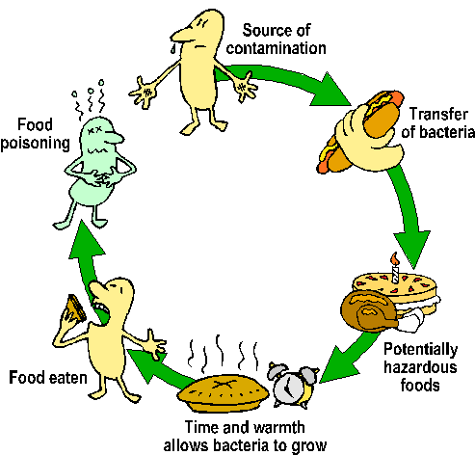
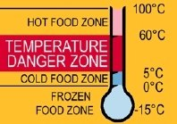
AQA Food Preparation & Nutrition Knowledge Organiser: Food Safety
You must be able to know the growth conditions for microorganisms and enzymes and the control of food spoilage. Know and understand that bacteria, yeasts and moulds are microorganisms. Explain that enzymes are biological catalysts usually made from proteins. Demonstrate the knowledge and understanding of the use of microorganisms in food production, including moulds in the production of blue cheese, yeast as a raising agent in bread.
Know and understand the different sources of bacterial contamination. Know and understand the main types of bacteria that cause food poisoning. Demonstrate knowledge and understanding of the main sources and methods of control of different food poisoning bacteria types. Recognise the symptoms of food poisoning. Know and understand the food safety principles when buying and storing food. Know and understand temperature control and the danger zone temperatures.
Key Points
Bacteria are found everywhere and need the right temperature, warmth, time, nutrients, pH level and oxygen to grow and multiply.
Microorganisms (bacteria) are used to make a wide range of food products.
Bacteria are used to make cheese, yogurt and bread.
The most important bacteria in food manufacturing are Lactobacillus species.
Bacterial contamination is the presence of harmful bacteria in our food, which can lead to food poisoning and illness.
As a food handler you must do everything possible to prevent this contamination.
What are the main symptoms of food poisoning?
Name three bacteria responsible for food poisoning?
Which groups of people are more at risk of food poisoning?
When handling food at any stage care must be taken to prevent contamination.
Everything possible must be done to control the conditions that allow bacteria to multiply causing food poisoning.
Keywords
Starter culture
Probiotic
Pathogens
Food Poisoning
Contamination
Salmonella
Staphylococcus Aureus
Clostridium Perfingens
Clostridium Botulinum
Bacillus Cereus
Food Borne disease
E Coli
Listeria
Campylobacter
Norovirus
Keywords
Use by date
Best before date
Frozen Food
Chilled Food
High risk foods
Low risk foods
Danger zone
Hygiene
KS4
Assessment - NTT
What are microorganisms?
What is the ideal temperature for bacterial growth?
What is the most important bacteria used in food manufacturing?
What are the two date marks you need to check when buying food?
What is the recommended temperature for chilled food?
What is the temperature range of the danger zone?
Explain the term cross contamination.
List four occasions during food preparation when you must wash your hands.
Keywords
Bacteria
Microorganisms
Moulds
Enzymes
Temperature
Moisture
Time
Nutrients
pH level
Oxidation

Slide 14
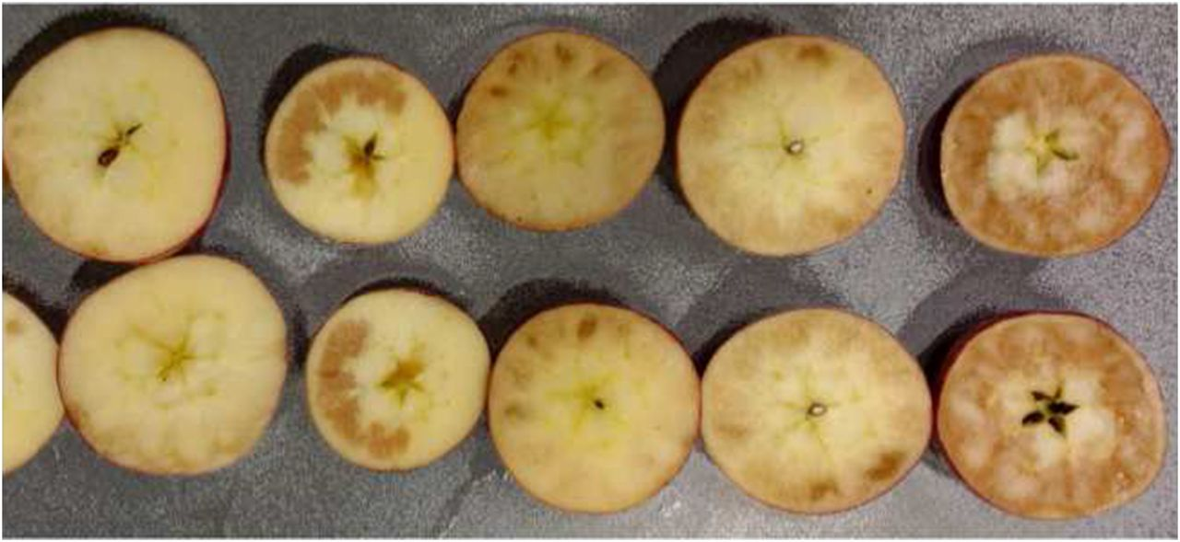
Keywords and definitions:
AQA Food Preparation & Nutrition Knowledge Organiser - Food Spoilage
Artificial additive: produced chemically and not copies of natural substances
Blanching: peeled and sliced fruits / vegetables are plunged into boiling water. The intense temperature will prevent enzyme action
Curds: a soft white substance when milk sours – used for cheese making
Enzymic browning: A chemical process where oxygen and enzymes react, causing food to go brown. It cannot be reversed
Micro-Organisms: The ones most commonly used / found in food are Yeast, Mould, Bacteria
Natural additive: obtained from natural sources such as extracts
Rennet: is an enzyme produced from vegetarian sources
Spores: a bacterium that has produced a string, protective outer coating.
Starter Culture: a bacteria mix used to ripen milk and help start the cheese making process
Synthetic additive: man-made copies of natural substances
Toxins: poisons that can cause illness
Whey: The watery part of milk that is left after curds are formed.
Enzymes:
Additives:
Enzymes are protein molecules that control chemical reactions in food. They are found in plants and animals and are inactive until food is either harvested or slaughtered. Once enzymes are activated, they can cause unwanted or undesirable changes in food such as colour, an example of this is enzymic browning.
Enzymes also turn starch into sugars in fruits, helping them ripen.
Additives are added to foods to perform a specific function. They can be Natural, Synthetic or Artificial. There are lots of different types of additives, depending on their function:
Preservatives prevent microbial growth which causes food spoilage. This can extend shelf life, examples are nitrite (E249) and nitrate (E252) added to ham and bacon.
Colours restore the original colour of food that has been lost through processing or storage. Some colour additives have been linked to hyperactivity in children.
Flavour enhancers bring out the natural flavour in some processed foods
Sweeteners are used to make a product sweeter, especially in drinks and diet foods.
Anti-caking agents are used to prevent dry food e.g. flour from sticking together
Emulsifiers help mix ingredients together that normally would not stay together like in mayonnaise
Stabilisers prevent ingredients from separating
Gelling agents are used to change the consistency of a food product. An example is Pectin (E440) which is used in jam.
Enzyme action can be prevented and controlled by:
A heat treatment such as blanching
Coating the sliced fruit / vegetables in an acid such as lemon juice
Bacteria:
Yeast:
Mould:
Bacteria are small single-celled organisms. They can only be seen under a microscope. They reproduce very quickly by splitting in 2 every 20 minutes (approximately). Best growth conditions are:
Moisture – Warmth (37°C is best) – A food Supply – Oxygen (for some bacteria)
Bacteria produce toxins which can be harmful to humans causing food poisoning. To prevent and control bacteria production:
Store food in the fridge between 0°C and 5°C
Cooked foods (that are not going to be eaten) should be cooled and stored at the above temperature within 90 minutes
Leftover food should only be reheated once – more than once and the bacteria will multiply into dangerous levels.
Bacteria in cheese and yoghurt production:
Milk is heat treated and cooled
Specific bacteria called a starter culture is added to the milk
The culture “ripens”, fermenting the lactose into lactic acid
FOR MILK: Rennet is added once enough lactic acid has formed, helping coagulate the mixture into curds and whey. They whey is drained and the curds are “scalded”. Cheese is pressed to remove any whey and set its final shape. It is then left to mature.
FOR YOUGHURT: the fermentation process allows the milk to coagulate. Sugar, sweetener, or fruit are added. It is chilled and packaged.
Yeast is widely used in the production of bread and some alcoholic drinks such as beer. Yeast is anaerobic, meaning it does no need oxygen to reproduce.
Yeast cells will reproduce with the following conditions:
Water / liquid
A food supply (e.g. a little sugar)
time
A warm environment
To prevent and control yeast production:
Keep yeast cold so that they are inactive or dormant
Keep dried / fresh yeast away from moisture
Yeast is killed at high temperatures (100°C and above)
Moulds are small plants that can grow on many types of foods. They have threads that grow up and roots that grow down to absorb the nutrients in the food.
They have a fuzzy appearance and are a type of fungi. They will often be blue/green, white or black in colour.
They reproduce by producing spores which travel in the air, and will grow on other things if the conditions are correct.
Some moulds are considered harmless and used in the production of cheese e.g. Danish Blue.
To prevent mould growth; store suitable foods in the fridge or in a cool dry place, managing the temperature. Cook to a high temperature to destroy heat resistant spores.
Signs of Food Spoilage:
Food Spoilage is a natural process caused by bacteria, moulds, enzymes and yeast. Food spoilage happens more quickly in warm, moist conditions. The signs of food spoilage are:
Discolouration
Changes in texture – wrinkly, slimy, lumpy, hard, sloppy
Visible mould
Unpleasant odour
Changes in flavour – e.g. sour milk
Can and jar lids have been “blown” out due to microorganisms producing gases in the jar / can.

Slide 15
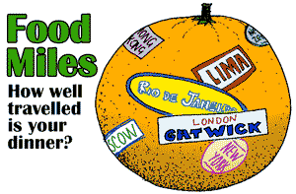
KS4
AQA Food Preparation & Nutrition Knowledge Organiser: Food Provenance
You must be able to demonstrate knowledge and understanding of the environment issues associated with food and its production. Demonstrate knowledge and understanding of where ingredients are grown, reared and caught. Have a clear understanding of different farming methods and their effect on the environment. Demonstrate knowledge and understanding of the impact that food has on local and global markets. Demonstrate a knowledge of primary and secondary processing. Know and understand how processing affects the sensory and nutritional properties of ingredients.
Keywords
Homogenised
Primary and Secondary processing
Pasteurised
Skimmed
Semi skimmed
Ultra heat treated (UHT)
Sterilised
Evaporated, Condensed
Keywords
Green house gases (GHG’s)
Crop rotation
Fairtrade
Red Tractor
Climate change
CFC’s
Sustainability of food
Deforestation
Keywords
Preservation
Temperature
Drying
Chemical Preservation
Modified Atmospheric Packaging
Vacuum packaging, Irradiation
Keywords
Traceability
Field to fork
Barn reared animals
Organic
Genetically Modified (GM)
Free range
Hydroponics
Fish Farms
Intensive farming
Key words
Transportation
Food Miles
Food Origin
Climate Change
Carbon Footprint
Recycling
Packaging
Landfill
Food Waste
Sustainability
Key Points
Food and packaging waste contributes to greenhouse gases (GHG’s)
Seasonal and sustainable foods address many environmental issues.
MSC – Marine Stewardship Council = Seafood can be traced back to a certified sustainable fishery.
Food miles are the distance food travels from its point of origin to your table. Recycling and producing less waste can help reduce carbon emissions.
Nearly a third of all food produced ends up in landfill sites where it gives off methane gas as it decomposes.
Cheaper foods are ones that are GM/intensively farmed
Best quality protein foods are ones where the welfare of the animals has been considered.
Hydroponic farming is the production of food using specially developed nutrient rich liquids rather than soil.
Free range farming allows animals to access outdoor areas as part of their life. Increased demand for fish stocks has seen stocks diminishing in the wild due to over fishing.
Barn reared animals live in an environment similar to intensive farming
Under EU law, all foods need to be traceable from field to fork.
Carbon emissions and global climate change affect food and water supplies. Sustainable food production ensures less negative impact on the environment and the farmers.
Assessment - NTT
Explain what food miles are.
Give two ways that fish stocks can be made more sustainable than intensive farming.
What are the benefits are free range farming>
Why is it important that the origins of food can be traced?
What does the flag on the Red Tractor logo mean?
How does Fairtrade support farmers in developing countries?
Which two gases contribute to global warming?
What is the outer skin on the wheat grain called?
What is homogenised milk?
What type of flour is used to make pasta?
Which vitamins may be lost during irradiation?
How does vacuum packaging differ to MAP?

Slide 16
Keywords and definitions:
AQA Food Preparation & Nutrition Knowledge Organiser-Where food comes from
Carbon Footprint: Carbon footprint is the total amount of Carbon Dioxide and other greenhouse gases that is produced during the entire production process of a product
Factory Farming: See Intensive Farming
Fairtrade: Fairtrade works to ensure better prices, decent working conditions and a fairer deal for farmers in lower economic and developing countries. The Fairtrade logo is put on the packaging of Fairtrade products
Farm assured: Means that farms have met high standards of food safety, hygiene, animal welfare and environmental protection. The Red Tractor logo (Assured Food Standards) is used in the UK to show that farms have met these standards. It also means that the product can be traced back to the farm where it was produced.
Free Range: associated with the production of meat and eggs. Means animals are not confined to small spaces all day and do have some time to roam free.
Food Bank: some families do not have access to healthy nutritious foods on a regular basis, a food bank is a service that provides these families with foods if they are not able to afford it themselves. It is however only a short term solution.
Food Provenance: The place where food originates i.e. where it is grown, raised, reared or caught
Food Security: When all people at all times have access to sufficient, safe, nutritious food to maintain a healthy and active lifestyle
GM Foods: Genetically Modified or GM foods pinpoint the gene that has a desired outcome, extracting it and copying it into another organism. It is currently used in crops such as tomatoes and maize, and may be used in animals in the future.
Intensive Farming: Producing as much food as possible over a small amount of space to yield high profits. Sometimes called Factory Farming.
Malnutrition: not getting enough of the needed nutrients due to poor diet.
Organic Farming: produces food without the use of herbicides, fertilisers, pesticides. Also means foods are free from GM foods and most additives.
Yield: How much meat / eggs / crops are produced at any given time.
Intensive Farming:
Organic Farming:
Seasonal Foods:
GM Foods:
Animals and crops are packed closely together
Lots of pesticides are used to prevent crops from becoming unhealthy – this can have a negative effect on the soil
Many animals become sick due to being cramped together, especially battery hens in cages.
Product quality is often lower
Many concerns over the welfare of animals.
Produces a higher quantity of crops or meat / eggs in a shorter amount of time. Meaning it is more efficient for companies to produce different products.
Generally higher quality food – some believe this results in greater nutritional benefits
Many people believe it tastes better
Better welfare for animals
More expensive as yield is smaller and takes longer to produce
Less ethical concerns
Relies on crop rotation to preserve the soil
We often take for granted the range of foods available in the supermarket. However lots of foods are often not in season in the UK, meaning they do not grow at that time of year, and are instead imported so that we can buy them.
Seasonal foods are foods that are available at specific times of year e.g. cucumber, strawberries and plums in the summer.
Buying seasonal foods reduces food miles, supports the local economy, tends to be fresher and taste better.
People often think of fruit and vegetables, but seasonal can also refer to meat and fish.
Advantages:
Can increase yield
Crops are resistant to diseases
Plants can grow in harsher environments
Cheaper
Longer shelf life
Disadvantages:
Altering DNA is controversial – some people feel it is tampering with nature
GM food and labelling is not always clear, so you cannot always tell if you are eating GM foods
May lead to new allergy outbreaks
Cross-pollination, leading to a mix of GM and non GM crops
Sustainability of food :
Food Miles:
Food Poverty:
Food sustainability looks at the impact of producing and consuming food worldwide. Food being sustainable means that the resources we use, should always be replaceable. Sustainable food should follow the following principles:
Aim to be waste free – by reducing food waste and package. Food should have minimum packaging and where possible be produced from recyclable / recycled material.
Buy local and seasonal foods – this minimises the energy used in food production, transport, and storage. It also helps the local economy
Eating a healthy diet – reducing foods with animal origins. Meat and dairy products are the largest producers of greenhouse gases in production
Choosing Fairtrade certified products – this scheme ensures workers are paid fairly
Only eating fish from sustainable sources – fish certified by the Marine Stewardship Council (MSC) has been caught sustainably. Overfishing is the biggest threat to marine wildlife and their habitats.
Getting the balance right – cut down on sugar, salt and fat and increase consumption of vegetables. In the UK poor diet is one of the leading health issues, whilst 15% of the world goes hungry.
Grow your own food – and buy the rest from small local businesses rather than relying on one large supermarket or corporation
Food miles is a way of calculating how far food has travelled to get to the consumer. Food miles include everything from farm, to factory, to processing, to supermarket, to consumer.
The higher the food miles of a product, the more carbon emissions and the more harmful to the environment it is.
You can reduce the food miles of products by:
Growing your own food
Buying from local stores and farms
Walk / bike / bus to the store rather than use a car
Compost / recycle waste (reducing food miles to landfill)
Food Poverty is when people do not have access to affordable, nutritious, healthy food on a regular basis.
Effects of food poverty include:
Restricted food choice resulting in poor diet
Diet related disease e.g. diabetes, obesity and CHD
Malnutrition
Poor concentration and more health issues in young children especially.
In the UK there has been a rise in food poverty and a rise in the amount of people who are relying on food banks.
People can make their money and food go further by; bulk buying, meal planning, using leftovers, comparing prices, batch cooking, checking best before date, etc

