Slide 1
Year 9
Knowledge Organisers

Slide 2
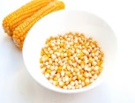
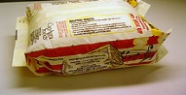
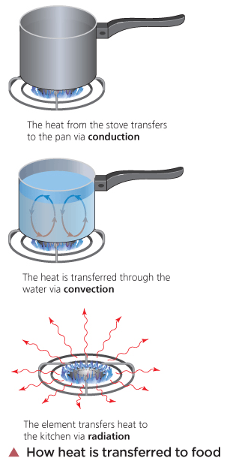
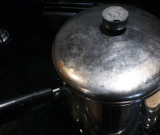
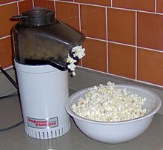
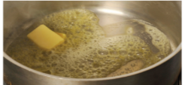
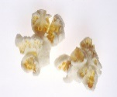
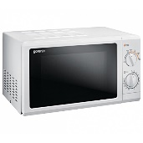
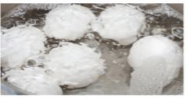
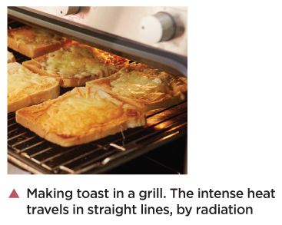
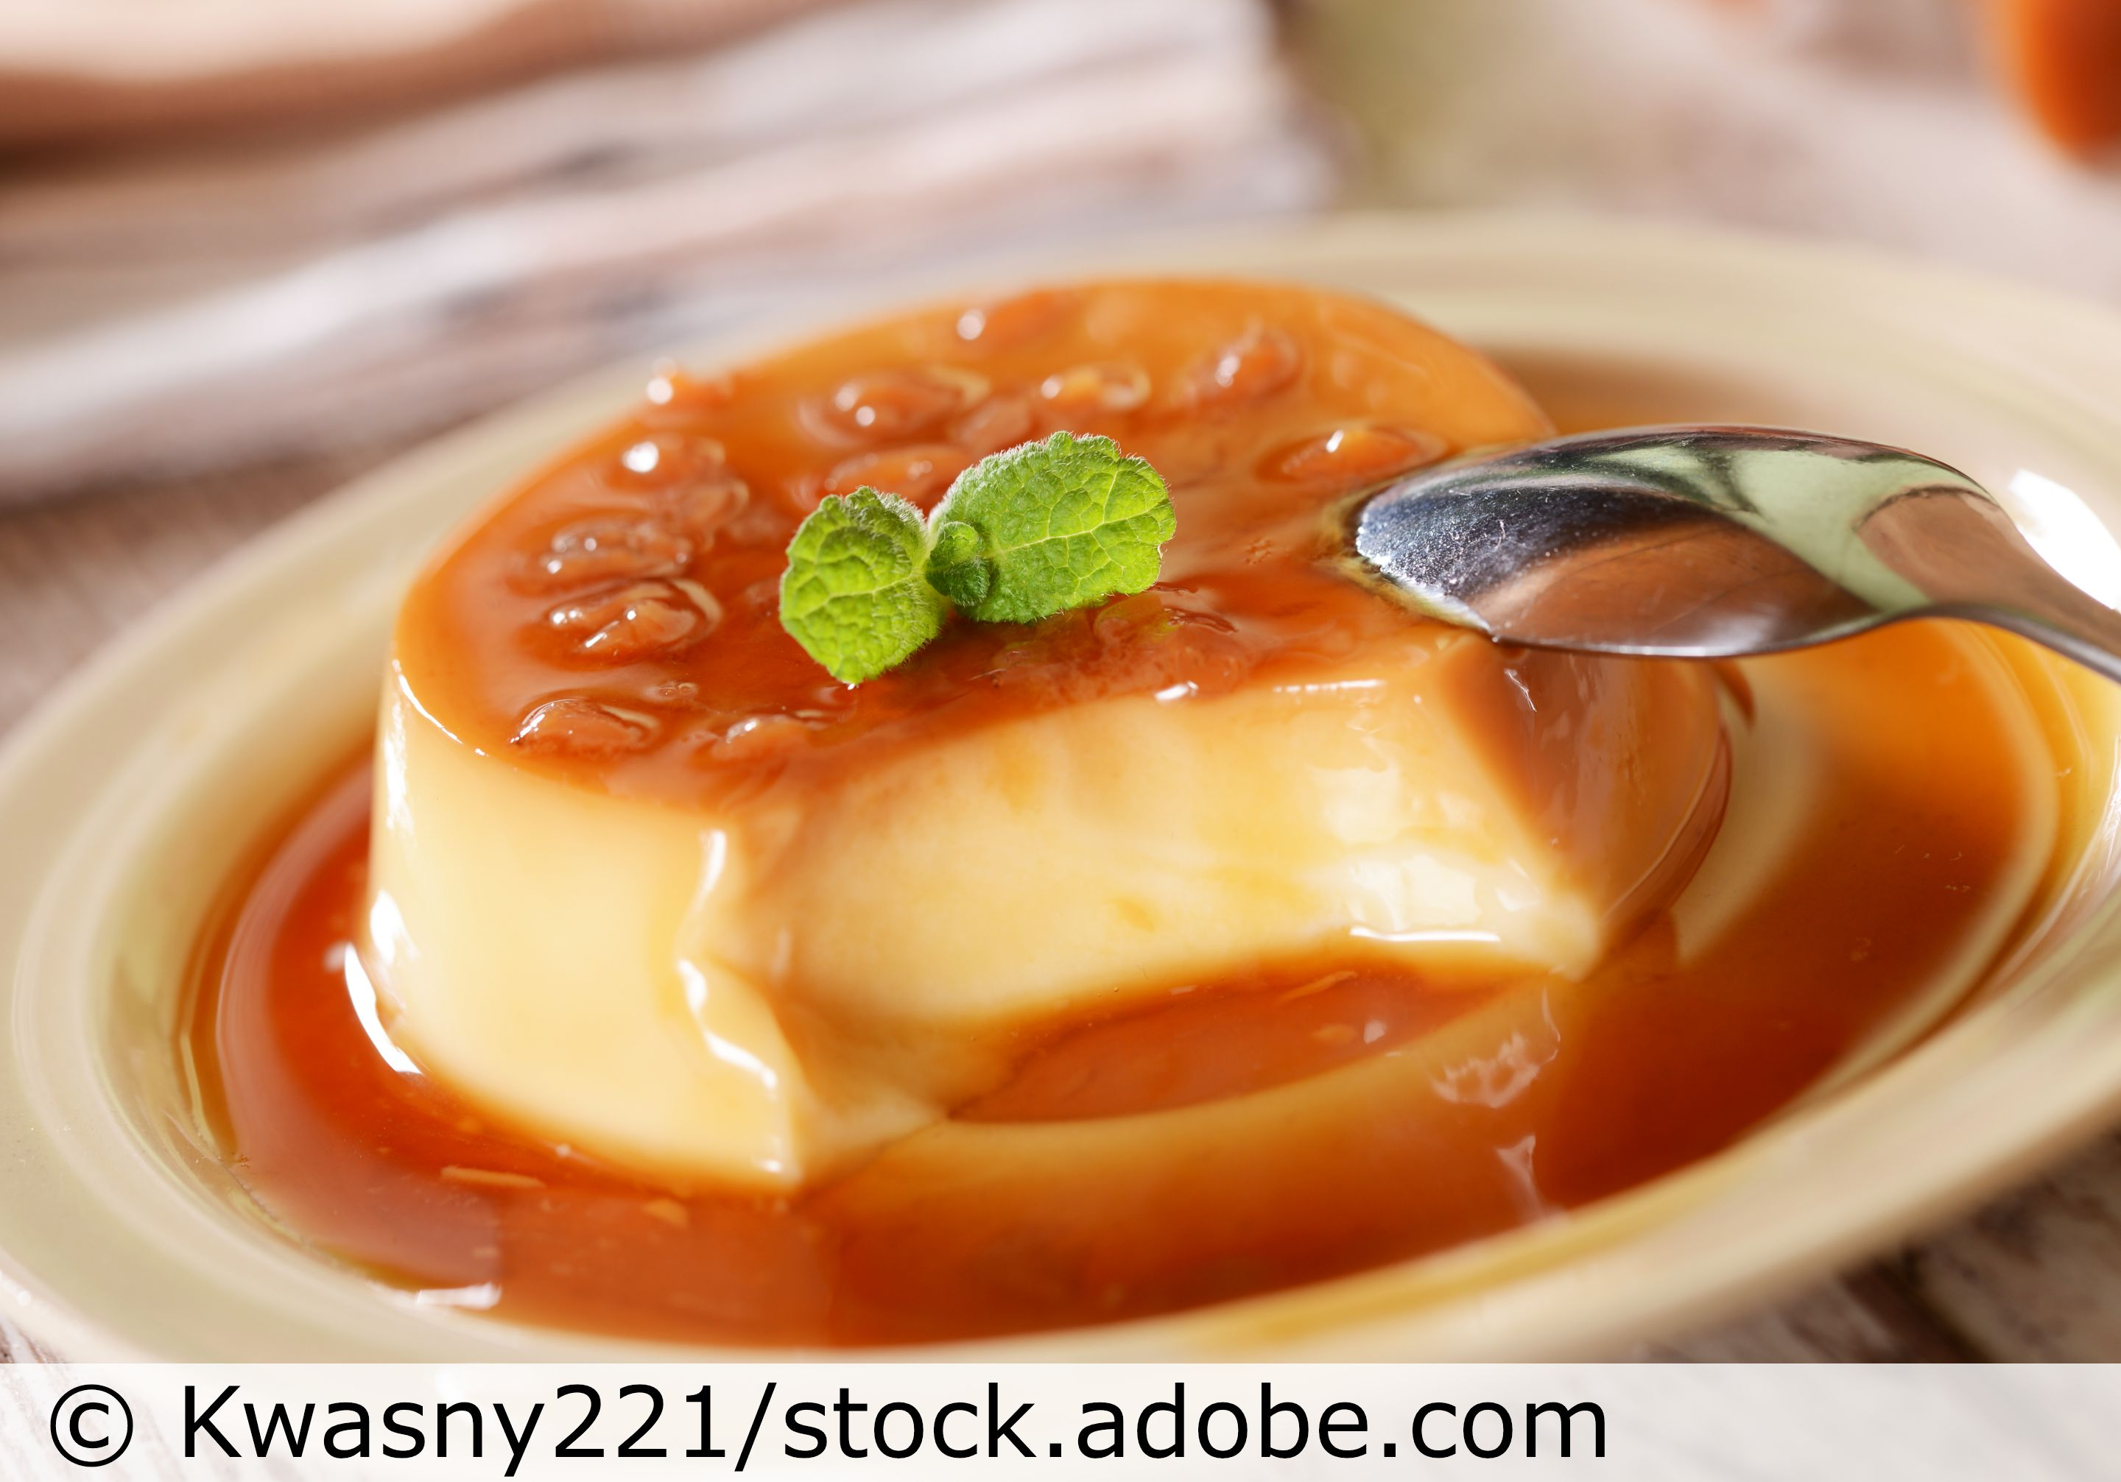
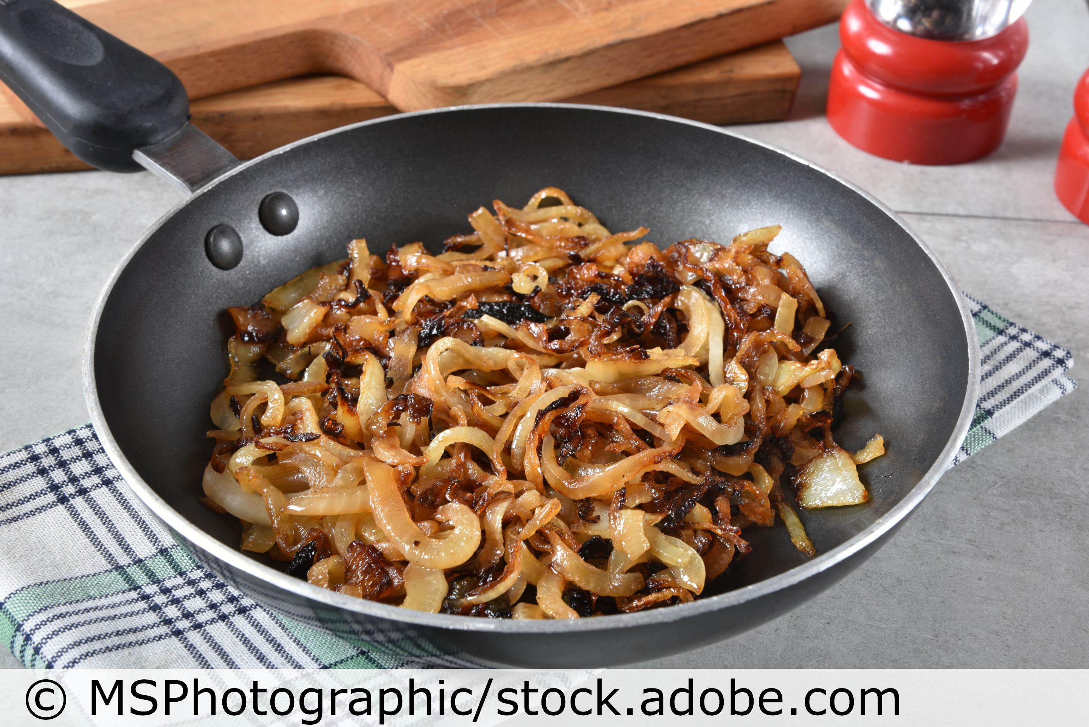
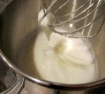
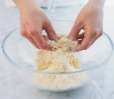
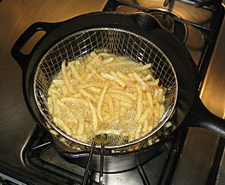
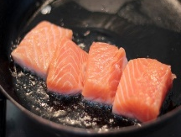
Year 9 – Is ‘food’ a science?
In Practice
Investigating popcorn
Which method of heat transfer
produces the best popcorn?
Justify your choice.
Research Task:
How does COOKING affect
the sensory and nutritional
properties of food?
How is food cooked?
Heat is transferred to food by
Conduction
Convection
Radiation
melting butter
c
c
poaching
Functional and chemical properties of food
Functional property-the role of ingredients in a mixture
grilling
Denature-protein changes shape.
Amino acid chains unfold by:
Heat eg fried egg
Acid eg lemon juice in a marinade tenderises chicken
Mechanical action eg when
Egg whites are whisked the
protein stretches into strands
and air is trapped.
A gas-in-liquid foam is formed when the
Liquid egg forms a film around each air bubble
Caramelisation
When sugar is heated, it changes colour and flavour.
Sugar turns from white/clear to dark amber.
An attractive flavour and golden colour develop.
eg caramel, crème caramel, caramelised onions
Overheating produces a bitter taste and a burnt appearance.
Cooking Methods
Cooking with dry heat
Baking | Cooked in the dry heat of the oven
Grilling | Cooked by the radiant heat of a hot grill. Direct heat.
Cooking with fat
Stir Fry | Cooked quickly over intense heat in a wok with little oil
Shallow Frying | Cooked in a shallow pan with hot fat
Deep Frying | Cooked submerged in very hot oil
Roasting | Cooked in the dry heat of the oven and basted with hot fat
Cooking with water
Boiling | Cooked quickly in boiling water – 100C
Poaching | Cooked in gentle simmering water – below boiling point
Dry heat
Shortening-when fats give biscuits and pastry a crumbly texture. The best fats to use are butter, lard, white vegetable fat (eg Trex) and baking margarine.
When fat is rubbed into the flour using fingertips, this surrounds the flour particles with a waterproof coating.
This stops water becoming absorbed into the flour and prevents biscuits and pastry becoming tough.
Aeration-is when air is trapped in a mixture to make it lighter and give it a spring texture.
Fat and sugar are creamed together.
Bubbles of air are created and a stable foam is formed ; the air stays trapped in the creamed mixture until it is cooked.
With fat
Coagulation happens when the protein in the food sets during the cooking process.
The heat of an electric
whisks sets egg white
The heat of an oven sets
eggs
Why is vinegar sometimes added to the
cooking water when poaching eggs?
Explain why an egg white can be set
but the yolk is still runny?
In your own words
and without looking at the KO
describe the process of caramelisation.
Self Assessment
Give an example of solid and liquid fats.
How does rubbing the fat into the flour
help to prevent pastry from being tough?
How does aeration help to keep cake mixtures light and springy?
With water
Do not forget cooking by microwave, raising agents, gelatinisation of starch in sauces and emulsification in mayonnaise are ……………… ‘scientific processes’.

Slide 3
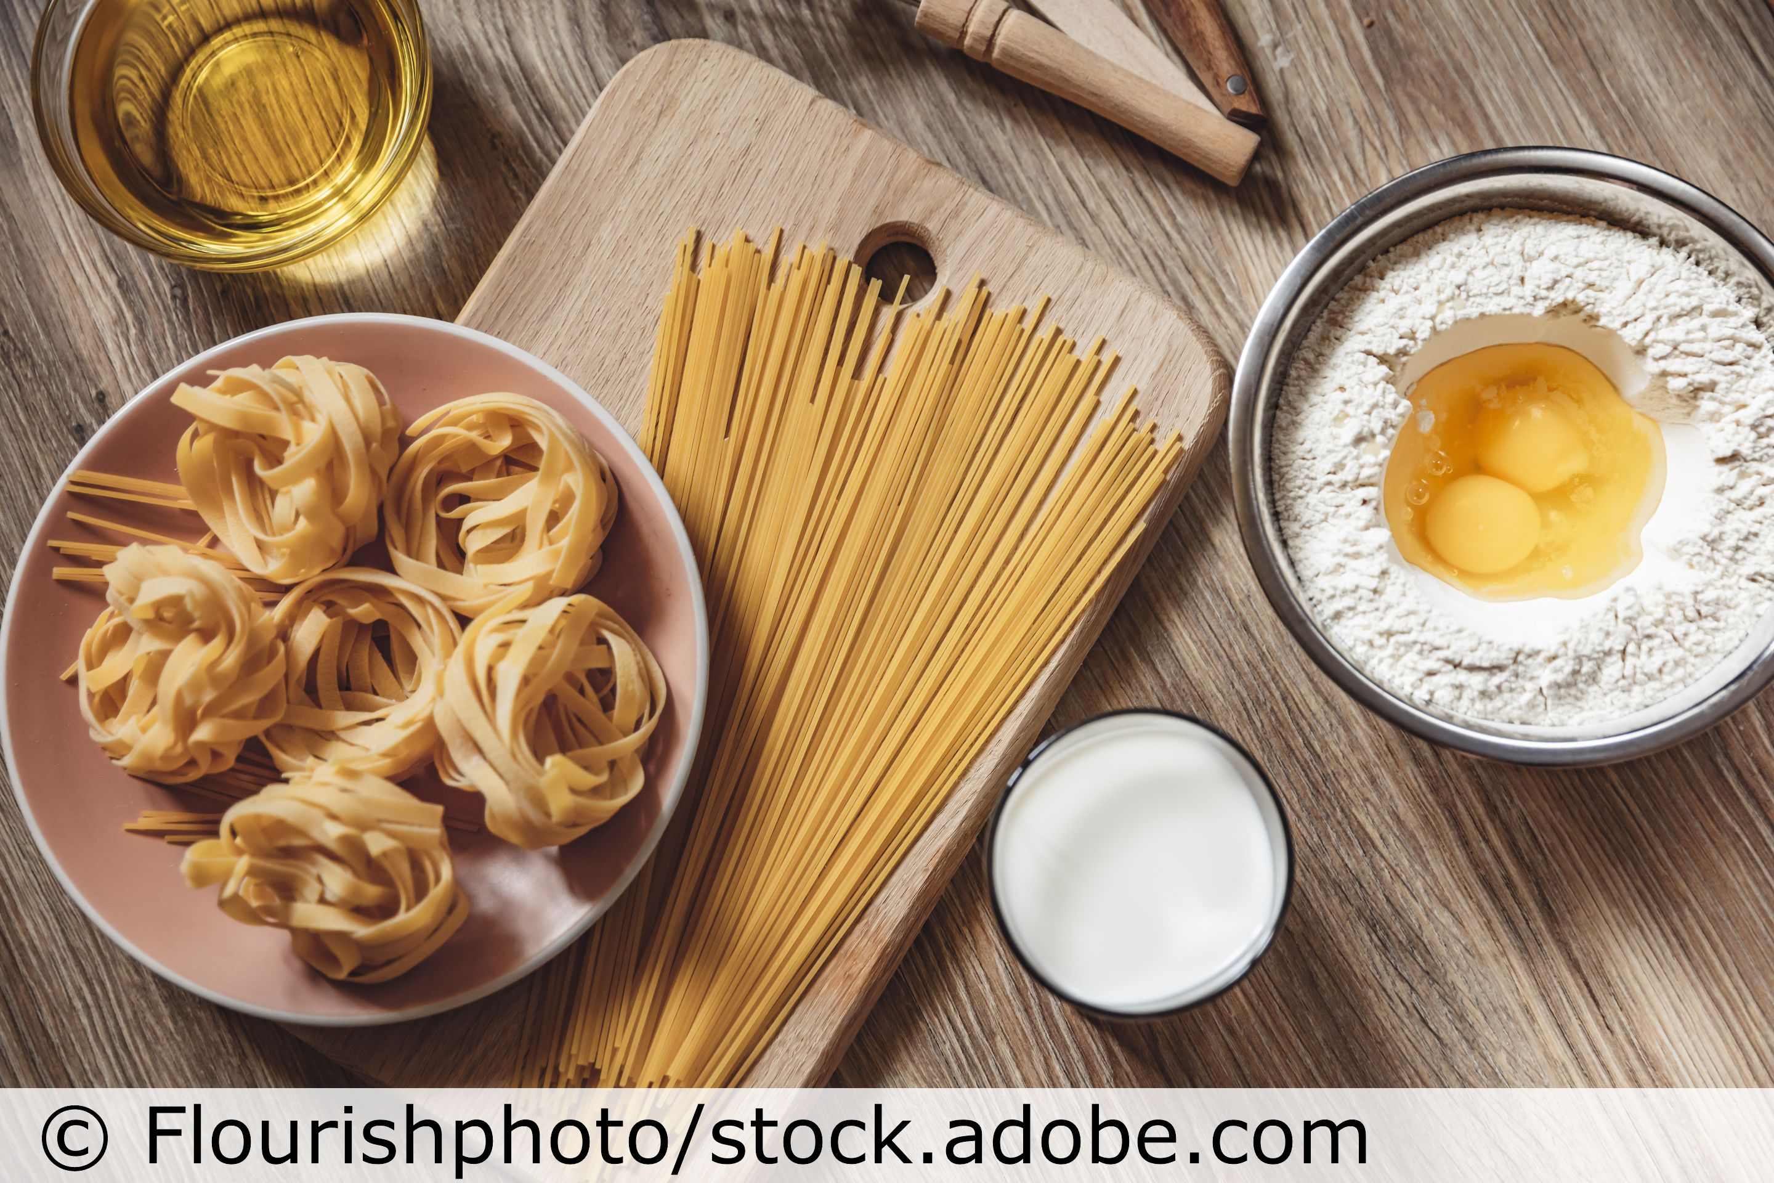
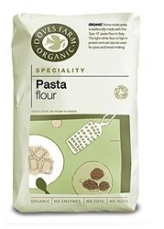
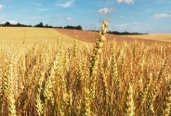
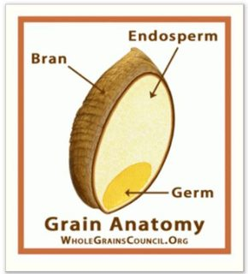
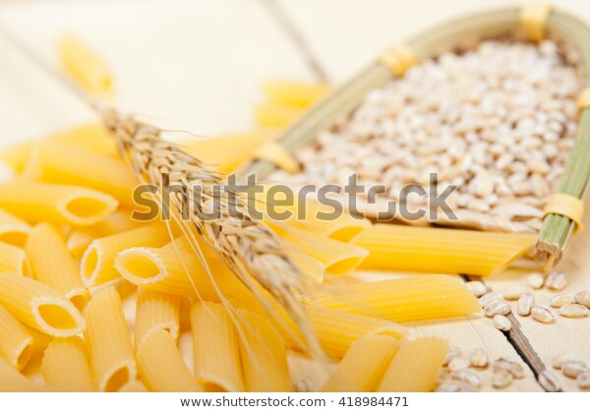
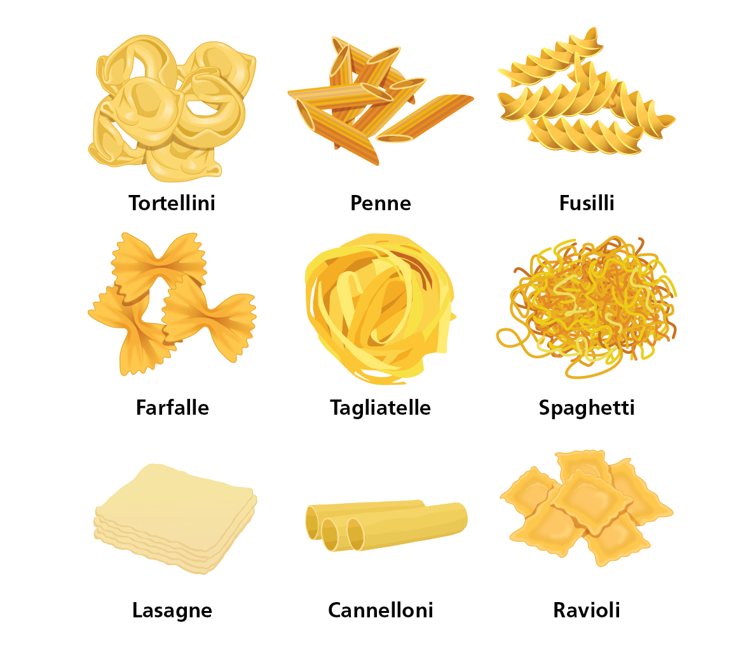
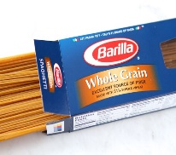
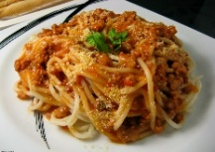
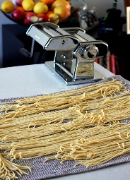
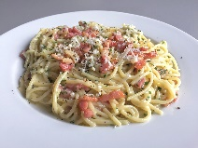
Year 9 – How is flour turned into pasta?
How is pasta dough made? Watch this video clip –
www.youtube.com/watch?v=dSyYir5Sc8A
A pasta machine is usually used to make different types of pasta.
The best flour used to make pasta is called durum wheat flour. It is sometimes called dopio zero (double zero) flour. Strong flour can also be used. It makes a stretchy dough and holds its shape during cooking due to the high gluten content.
Flour is produced through the milling process. Wheat, a cereal grain is ground down to make flour. This is an example of primary processing.
The type of flour depends on how much of the wheat grain is found in the flour. This is called the extraction rate. The higher the extraction rate the more fibre is found in the flour eg 100% gives wholemeal flour and 70% gives white flour.
White flour is fortified with calcium, iron and B-vitamins because they are removed when the flour is processed
A basic pasta dough is made from flour, salt, eggs, oil and water.
200g 00 flour/Strong
plain flour
Half a teaspoon salt
1 tablespoon oil
2 eggs
1 to 2 tablespoons water
There are many different shapes and varieties of dried pasta
for example farfalle – bow ties, penne – tubes, fusilli - twists
Place the flour and salt on the worktop and mix in the rest of the ingredients using your hands.
Knead the dough until it is smooth (about 5 minutes).
Roll the dough using a pasta machine, and cut into the desired shape. If a pasta machine is not available, roll the pasta on a well-floured surface to a thickness of about 0.5mm.
Cook the pasta shapes in a pan half full of boiling water with half a teaspoon of salt added for 3 to 5 minutes or until it is al dente (firm to bite).
Drain and add some grated cheese, tomato sauce and black pepper if you wish, and taste.
Dried pasta has a firm, solid texture. Served with chunky vegetable and meat sauces eg Bolognese sauce.
Primary processing means changing the raw food material into food that can be either eaten immediately or processed into other types of food.
Gluten is a protein which is formed when water is added to the flour and mixed.
Fortified -vitamins and minerals are added to foods to improve the nutritional value eg calcium is added to flour.
Fresh pasta has a softer texture and will absorb the flavours of the sauce it is served with eg carbonara
Self Assessment
Why is bread dough made with strong plain flour?
Why is pasta made with dopio zero flour?
Describe the difference between dried and fresh pasta and give examples of dishes they could be used for.
In Practice
Make a dish using pasta such as carbonara, lasagne or
Make some pasta dough, create some shapes, cook them and add to a reduction tomato sauce.
Extension
Investigate bread making. You made bread dough in Year 8 why not try and make some at home. You could make some garlic bread to serve with the pasta dish. Enjoy!

Slide 4
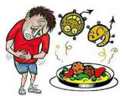
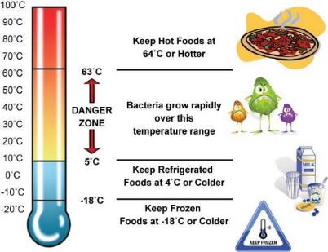
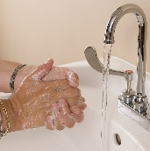
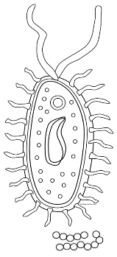
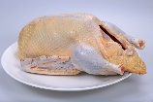
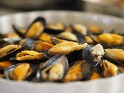
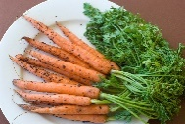
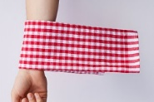
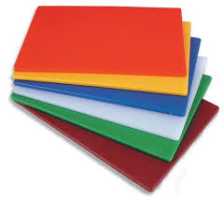
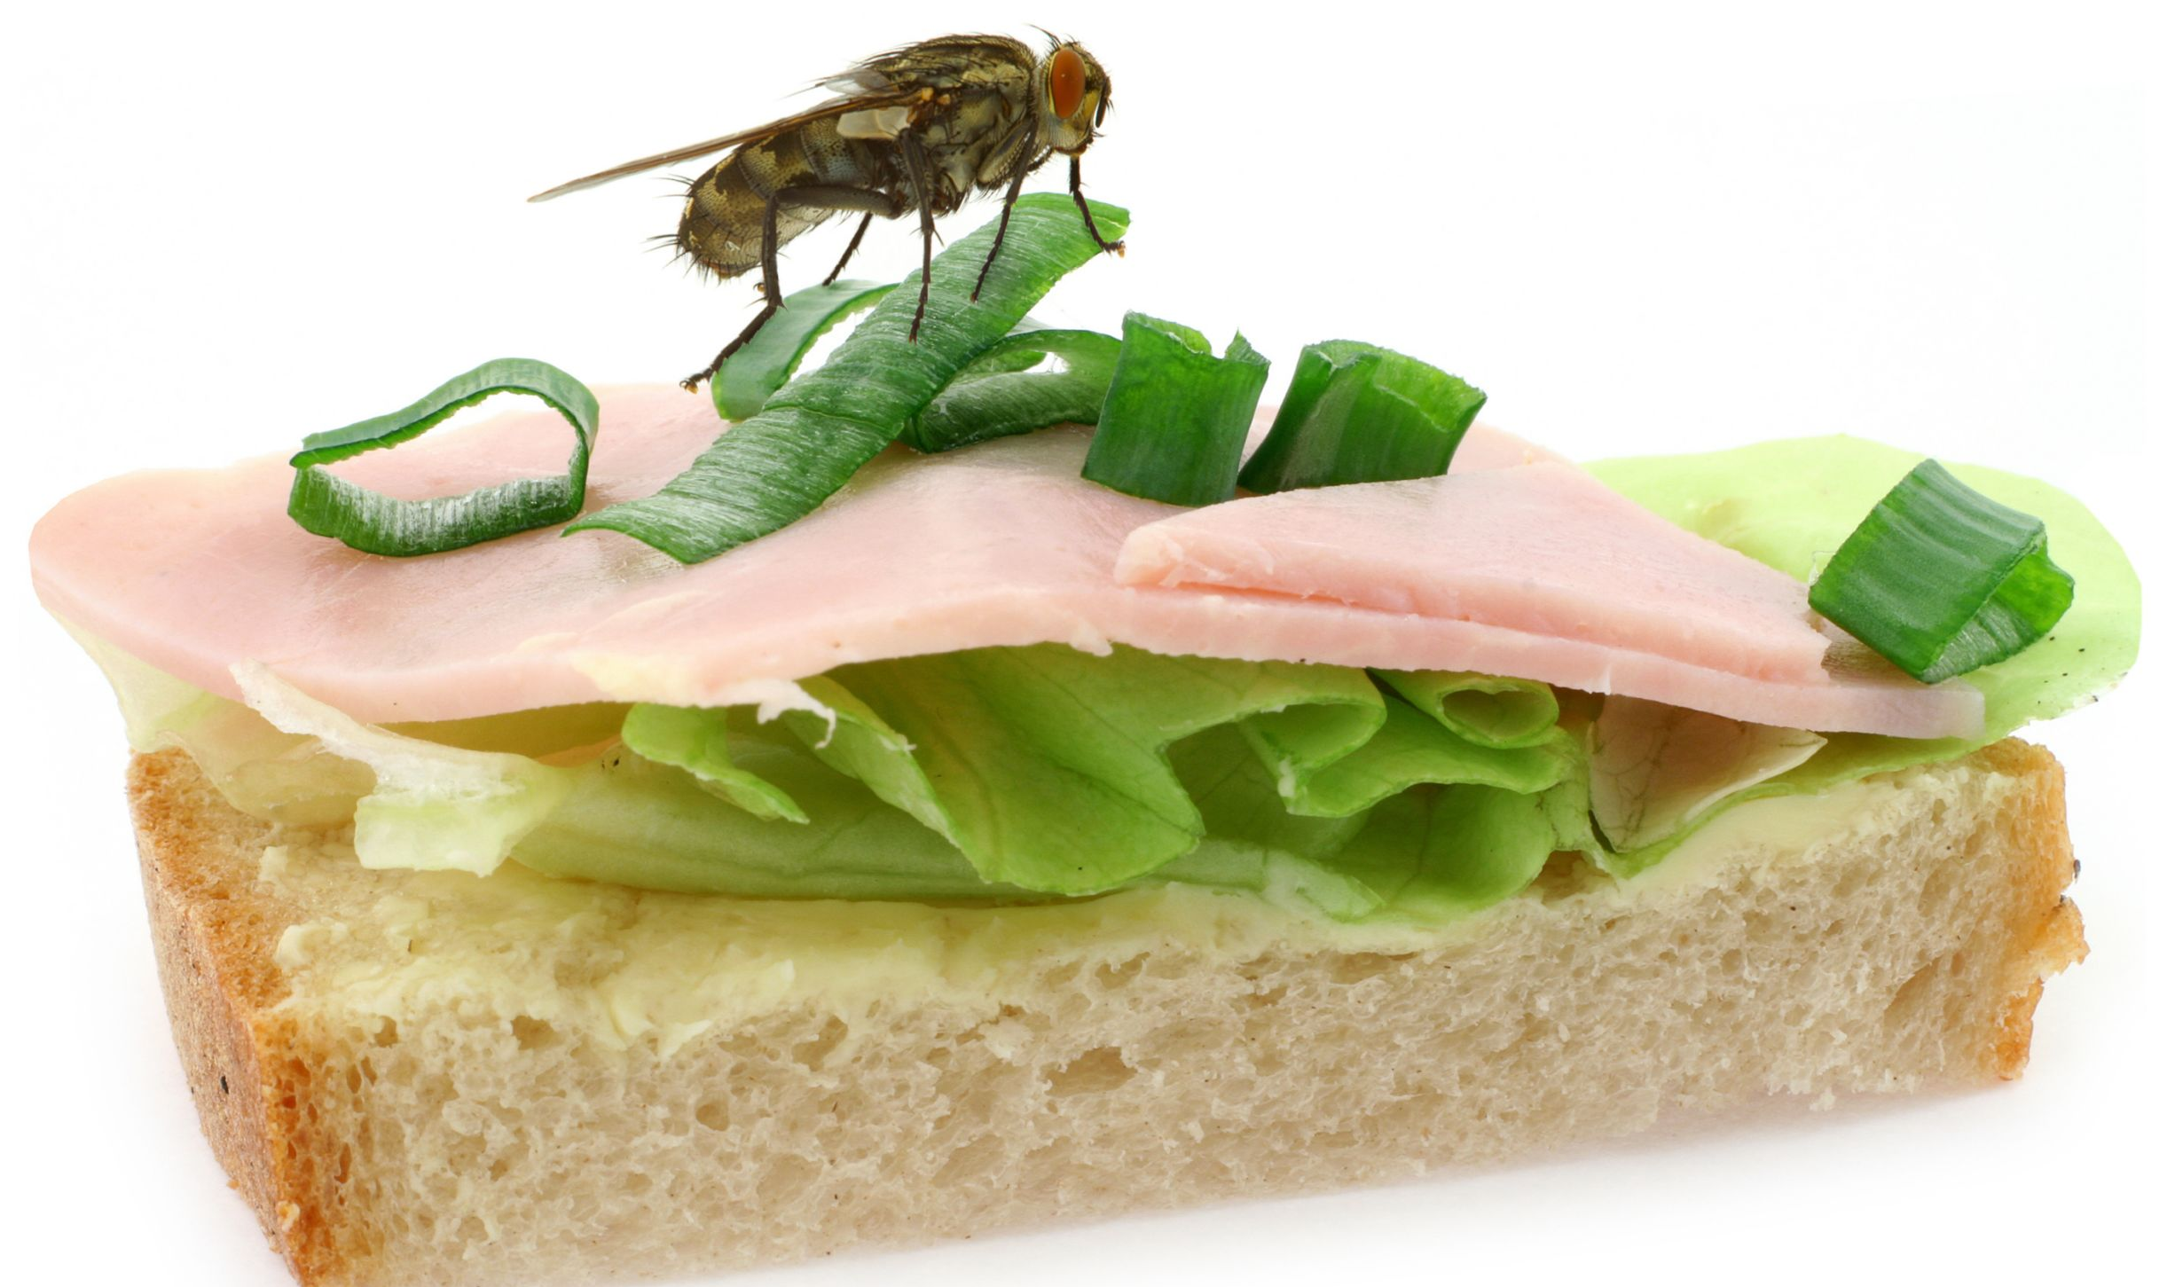
Year 9 - Where do bacteria come from?
Food poisoning is caused by eating food contaminated with harmful bacteria. This causes symptoms such as nausea, vomiting, diarrhoea and stomach pain. Food poisoning usually lasts a short time and the symptoms are mild.
For some people, the symptoms are very serious and can even cause death.
What are bacteria?
Bacteria come from:
Food Handlers
Handwashing is very important to
prevent unclean hands spreading bacteria on to food.
Double-dipping when tasting food passes
bacteria from your mouth into the food.
Licking fingers, touching the face and hair,
and picking the nose may all contaminate
food, dishes and equipment.
Bacteria grow best in the danger zone which is between 5◦C and 63◦C
Below 5◦C they are dormant, this means that grow very slowly or not at all
Above 63◦C they are mainly destroyed by the heat
Bacteria: microscopic living organisms, which are single-celled and can be found everywhere
Food poisoning: an illness caused by eating food contaminated with harmful bacteria
Pests: insects or animals which may contaminate food.
High-risk foods: ready-to-eat moist foods, usually high in protein
Temperature Danger Zone: temperatures between 5◦C and 63◦C where most bacteria can multiply
Raw Foods
Raw meat, poultry and their juices.
Eggs and shellfish carry bacteria on their shells, both inside and outside.
Soil on foods such as uncooked rice and root vegetables.
Cooking food above 75◦C kills bacteria
Waste food and rubbish
Bins with no lids attract pests.
Thin bin bags can split and contaminate areas.
Rubbish sometimes overflows.
Dirty bins allow bacteria to multiply
Self Assessment
What are the 5 main sources of bacteria which can contaminate food?
State 3 way you could prevent bacteria from raw food contaminating ready-to-at food?
Why are colour-coded chopping boards useful when preparing foods?
Name 3 symptoms of food poisoning.
Research:
Find out the names of different food poisoning bacteria. Write them out several times so you learn to spell them.
Check out bacteria www.bbc.com/bitesize/clips/zqt87ty
Pests
This is more likely to happen when:
food is left uncovered
bins are overflowing
areas and equipment are not cleaned properly.
Work Surfaces and equipment
Dirty tea towels and dish cloths.
Dirty equipment.
Using the same chopping board for raw and cooked food.
Colour coding of equipment helps to prevent cross-contamination

